Slide 1



CanSat 2018 Preliminary Design Review (PDR)
Outline
Team Logo
Here
(If You Want)
Team Logo
Here
Version 1.0
Team # 5002 Manchester CanSat Project
CanSat 2017 PDR: Team 5002 Manchester CanSat Project
1

Slide 2

Presentation Outline
Team Logo
Here
(If You Want)
This review follows the sub-sections listed below:
Section | Presenter
Systems Overview | Lawrence Allegranza France (LAF)
Sensors Subsystem Overview | Iuliu Ardelean (IA)
Descent Control Design | Iuliu Ardelean (IA)
Mechanical Subsystem Design | Lawrence Allegranza France (LAF)
Communications and Data Handling Subsystem Design | Lawrence Allegranza France (LAF)
Electrical Power Subsystem | Lawrence Allegranza France (LAF)
Flight Software Design | Lawrence Allegranza France (LAF)
Ground Control System Design | Lawrence Allegranza France (LAF)
CanSat Integration and Testing | Lawrence Allegranza France (LAF)
Mission Operations and Analysis | Iuliu Ardelean (IA)
Requirements Compliance | Iuliu Ardelean (IA)
Management | Iuliu Ardelean (IA)
Presenter: Iuliu Ardelean (IA)
2

Slide 3

Team Organization
Team Logo
Here
(If You Want)
Team Member | Responsibility
Iuliu Ardelean (IA) | CE, SE, GCS
Zuzanna Nagadowska (ZN) | PM, EPS
Lawrence Allegranza France (LAF) | I&T, CDH
Nicole Zieba (NZ) | CDH, SE, GCS
Robert Stana (RS) | FSW, SE
Alex Shelley (AS) | ME, DCS
Davis Joseph (DJ) | ME, DCS
Julia Stankiewicz (JS) | ME, DCS
Zair Chaudhry (ZC) | ME, DCS
Nacho Salsas Leon (NSL) | ME, DCS
Iuliu Ardelean Chief Engineer
Kate Smith Academic Advisor
Zuzanna Nagadowska
Project Manager
Mechanical Subsytem
Electronics Subsytem
Integration and testing
Ground Control Station
Alex Shelley 3rd Year
Iuliu Ardelean 3rd Year
Lawrence Allegranza France
Iuliu Ardelean
Davis Joseph 4th Year
Zuzanna Nagadowska
2nd Year
Julia Stankiewicz 2nd Year
Nicole Zieba 4th Year
Zair Chaudhry 3rd Year
Lawrence Allegranza France
4th Year
Nacho Salsas 3rd Year
Robert Stana 3rd Year
Presenter: Iuliu Ardelean (IA)
3

Slide 4
Acronyms
Team Logo
Here
(If You Want)
HS | Heat shield
CDH | Communications and Data Handling
EPS | Electrical Power Subsystem
FSW | Flight Software
GCS | Ground Control Station
ME | Mechanical Subsystem
SE | Sensors Subsystem
DCS | Descent Control Subsystem
CE | Chief Engineer
PM | Project Manager
I&T | Integration and Testing
CONOPS | Concept of Operations
GUI | Graphical User Interface
IDE | Integrated Development Environment
RTC | Real Time Clock
I2C | Inter-Integrated Circuit
SPI | Serial Peripheral Interface
ADC | Analog to Digital Converter
EEPROM | Electrically Erasable Programmable Read- only memory
TBC | To be confirmed
TBD | To be determined
RE# | Top Level Requirement
SL | System Level
SSL | Subsystem Level
A | Analysis
I | Inspection
T | Testing
D | Demonstration
Presenter: Iuliu Ardelean (IA)
4

Slide 5
Systems Overview
Team Logo
Here
(If You Want)
Team Logo
Here
Presenter
Lawrence Allegranza France (LAF)
5

Slide 6
Mission Summary
Team Logo
Here
(If You Want)
Objectives:
Build a CanSat with an atmospheric-sampling Probe, a single hen’s Egg, a Heatshield and a Parachute.
The CanSat shall be launched in a sounding rocket to an altitude of 675-725 meters.
After release from rocket payload bay, the CanSat shall deploy the Heatshield, and descend to an altitude of 300 meters without tumbling.
At 300 meters, the CanSat shall release the Heatshield and deploy a Parachute.
The Probe shall collect and transmit atmospheric data to a Ground Control Station in real-time, throughout its operation phase.
The Proble shall land leaving the egg intact, after which it will continuously operate an audio beacon.
The Ground Control Station shall receive and display CanSat data.
Selectable Bonus and Rationale:
Camera Bonus selected because of abundant team members experience.
External Objectives:
Continue to deliver Manchester CanSat Project weekly, educational, space-related Workshops towards University of Manchester STEM Students.
Develop a UK CanSat Competition.
Inspire other UK Universities and Academic Institutions to adopt the Manchester CanSat Project model to create a network of CanSat societies across the UK.
Presenter: Lawrence Allegranza France (LAF)
6

Slide 7
System Requirement Summary
Team Logo
Here
(If You Want)
RE# | Description | A | I | T | D
RE1 | Total mass of the CanSat (probe) shall be 500 grams +/- 10 grams. |  | X |  | X
RE2 | The aero-braking heat shield shall be used to protect the probe while in the rocket only and when deployed from the rocket. It shall envelope/shield the whole sides of the probe when in the stowed configuration in the rocket. The rear end of the probe can be open |  | X |  | X
RE3 | The heat shield must not have any openings. |  | X
RE4 | The probe must maintain its heat shield orientation in the direction of descent. |  | X
RE5 | The probe shall not tumble during any portion of descent. Tumbling is rotating end-over-end.
RE6 | The probe with the aero-braking heat shield shall fit in a cylindrical envelope of 125 mm diameter x 310 mm length. Tolerances are to be included to facilitate container deployment from the rocket fairing. |  | X |  | X
RE7 | The probe shall hold a large hen's egg and protect it from damage from launch until landing. |  |  | X | X
RE8 | The probe shall accommodate a large hen’s egg with a mass ranging from 54 grams to 68 grams and a diameter of up to 50mm and length up to 70mm. |  |  |  | X
RE9 | The aero-braking heat shield shall not have any sharp edges to cause it to get stuck in the rocket payload section which is made of cardboard. | X | X |  | X
RE10 | The aero-braking heat shield shall be a florescent color; pink or orange. | X | X
RE11 | The rocket airframe shall not be used to restrain any deployable parts of the CanSat. | X |  |  | X
RE12 | The rocket airframe shall not be used as part of the CanSat operations. | X |  |  | X
RE13 | The CanSat, probe with heat shield attached shall deploy from the rocket payload section. |  |  | X
RE14 | The aero-braking heat shield shall be released from the probe at 300 meters. | X |  | X | X
RE15 | The probe shall release a parachute at 300 meters. | X |  | X | X
RE16 | All descent control device attachment components (aero-braking heat shield and parachute) shall survive 30 Gs of shock. | X |  | X
RE17 | All descent control devices (aero-braking heat shield and parachute) shall survive 30 Gs of shock. | X |  | X
RE18 | All electronic components shall be enclosed and shielded from the environment with the exception of sensors. |  | X
RE19 | All structures shall be built to survive 15 Gs of launch acceleration. | X |  | X
RE20 | All structures shall be built to survive 30 Gs of shock | X |  | X
RE21 | All electronics shall be hard mounted using proper mounts such as standoffs, screws, or high performance adhesives. |  | X
Presenter: Lawrence Allegranza France (LAF)
7

Slide 8
System Requirement Summary
Team Logo
Here
(If You Want)
RE# | Description | A | I | T | D
RE22 | All mechanisms shall be capable of maintaining their configuration or states under all forces |  |  | X
RE23 | Mechanisms shall not use pyrotechnics or chemicals. | X
RE24 | Mechanisms that use heat (e.g., nichrome wire) shall not be exposed to the outside environment to reduce potential risk of setting vegetation on fire. | X |  | X | X
RE25 | During descent, the probe shall collect air pressure, outside air temperature, GPS position and battery voltage once per second and time tag the data with mission time. | X | X | X | X
RE26 | During descent, the probe shall transmit all telemetry. Telemetry can be transmitted continuously or in bursts. |  |  | X | X
RE27 | Telemetry shall include mission time with one second or better resolution. Mission time shall be maintained in the event of a processor reset during the launch and mission. |  |  | X | X
RE28 | XBEE radios shall be used for telemetry. 2.4 GHz Series 1 and 2 radios are allowed. 900 MHz XBEE Pro radios are also allowed. |  | X
RE29 | XBEE radios shall have their NETID/PANID set to their team number. |  | X | X | X
RE30 | XBEE radios shall not use broadcast mode. |  | X | X | X
RE31 | Cost of the CanSat shall be under $1000. Ground support and analysis tools are not included in the cost. | X | X
RE32 | Each team shall develop their own ground station. |  |  |  | X
RE33 | All telemetry shall be displayed in real time during descent. |  |  | X | X
RE34 | All telemetry shall be displayed in engineering units (meters, meters/sec, Celsius, etc.) |  | X |  | X
RE35 | Teams shall plot each telemetry data field in real time during flight |  |  | X | X
RE36 | The ground station shall include one laptop computer with a minimum of two hours of battery operation, XBEE radio and a hand held antenna. |  | X
RE37 | The ground station must be portable so the team can be positioned at the ground station operation site along the flight line. AC power will not be available at the ground station operation site. |  | X
RE38 | Both the heat shield and probe shall be labeled with team contact information including email address. |  |  |  | X
RE39 | The flight software shall maintain a count of packets transmitted, which shall increment with each packet transmission throughout the mission. The value shall be maintained through processor resets. |  | X |  | X
Presenter: Lawrence Allegranza France (LAF)
8

Slide 9
System Requirement Summary
Team Logo
Here
(If You Want)
RE# | Description | A | I | T | D
RE40 | No lasers allowed. | X |  |  | X
RE41 | The probe must include an easily accessible power switch. | X | X |  | X
RE42 | The probe must include a power indicator such as an LED or sound generating device. |  | X | X | X
RE43 | The descent rate of the probe with the heat shield deployed shall be between 10 and 30 meters/second. | X |  | X
RE44 | The descent rate of the probe with the heat shield released and parachute deployed shall be 5 meters/second. | X |  | X
RE45 | An audio beacon is required for the probe. It may be powered after landing or operate continuously. |  | X | X | X
RE46 | Battery source may be alkaline, Ni-Cad, Ni-MH or Lithium. Lithium polymer batteries are not allowed. Lithium cells must be manufactured with a metal package similar to 18650 cells. |  | X | X | X
RE47 | An easily accessible battery compartment must be included allowing batteries to be installed or removed in less than a minute and not require a total disassembly of the CanSat. | X | X |  | X
RE48 | Spring contacts shall not be used for making electrical connections to batteries. Shock forces can cause momentary disconnects. |  | X
RE49 | A tilt sensor shall be used to verify the stability of the probe during descent with the heat shield deployed and be part of the telemetry. |  | X | X | X
Bonus 1 | Camera: Add a color video camera to capture the release of the heat shield and the ground during the last 300 meters of descent. The camera must have a resolution of at least 640x480 and a frame rate of at least 30 frames/sec. The camera must be activated at 300 meters. | X | X | X | X
Bonus 2 | Wind Sensor: A radio transmitter shall be added to transmit the wind speed by changing its 10 frequency. The frequency change shall be 1 Hz per 0.1 meter/sec. The transmitter must be custom designed and built. It cannot be a commercial product. The frequency must be in the 433 MHz ISM band or if a team member has an amateur radio license, an amateur radio band can be used. The transmitter must be able to be set to 8 different frequencies in the 433 MHz ISM band with 25 KHz separation. The transmitter must turn off after the probe lands to minimize interference. The team can use a commercial receiver. | X | X | X | X
Presenter: Lawrence Allegranza France (LAF)
9

Slide 10
System Level CanSat Configuration Trade & Selection
Team Logo
Here
(If You Want)
CONCEPT 1 | CONCEPT 2
Spring loaded HS with carbon fiber rods skeleton. | Origami Heatshield.
Removable hatch door egg protection structure. | Hinged door egg protection structure.
Deployment with movable rotating mechanism with actuator. | Deployment with rod extension mechanism with dynamo.
HS passive stability control strategy with fin-like shape. | HS passive stability control with grooves oriented in a spiral.
Concept Chosen | Rationale
CONCEPT 1 | Lighter Mass Easier to Integrate
Both concepts are compliant with the requirements, hence the most important factor is weight, followed by integration and manufacturing effort.
Concept 1 promises to be lighter and easier to integrate for the use of simpler mechanisms and structures.
Presenter: Lawrence Allegranza France (LAF)
10

Slide 11
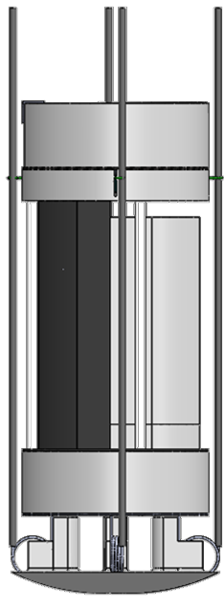
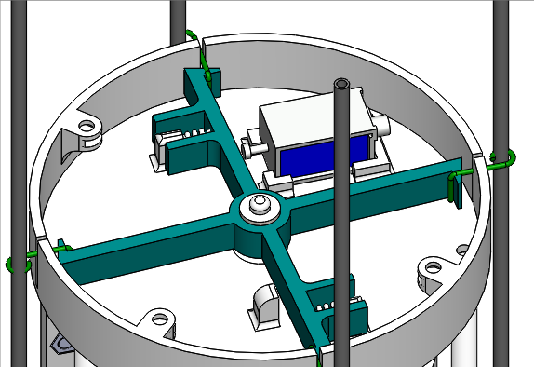
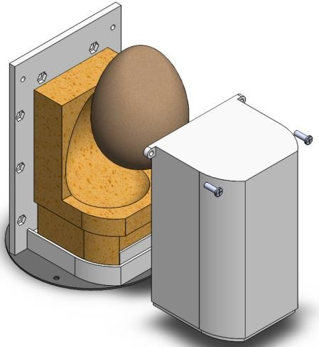
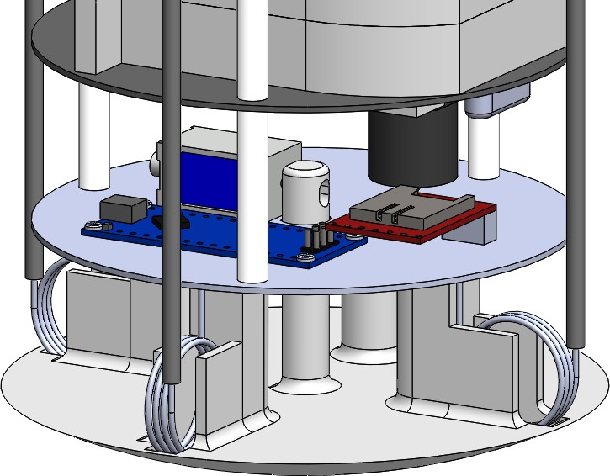
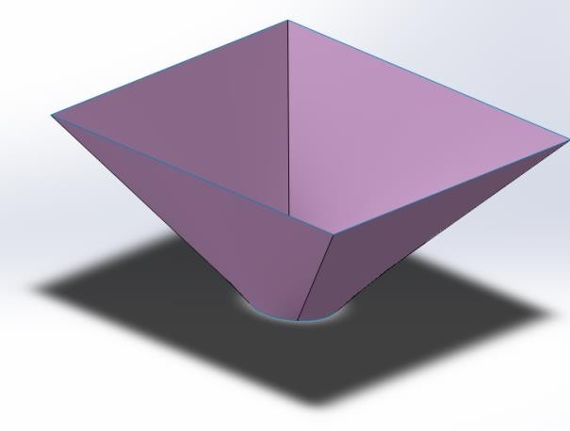
System Level CanSat Configuration Trade & Selection
Team Logo
Here
(If You Want)
CONCEPT 1 (Chosen)
Rotating deployment mechanism with actuator
Removable hatch door
Spring-loaded Carbon fiber rods HS
HS with fin-like shape
Presenter: Lawrence Allegranza France (LAF)
11

Slide 12
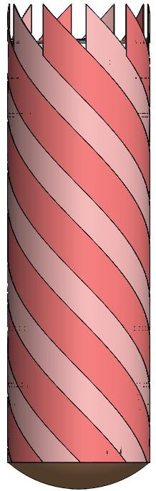
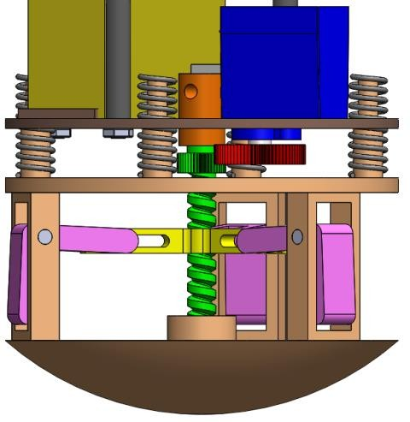
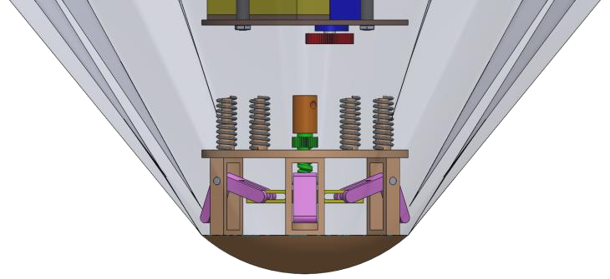
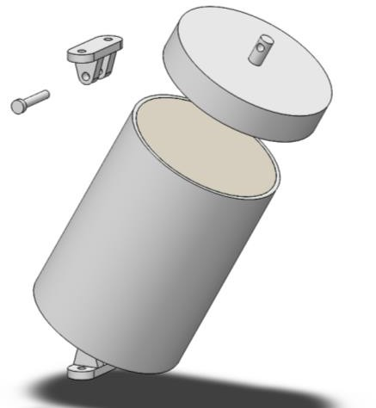
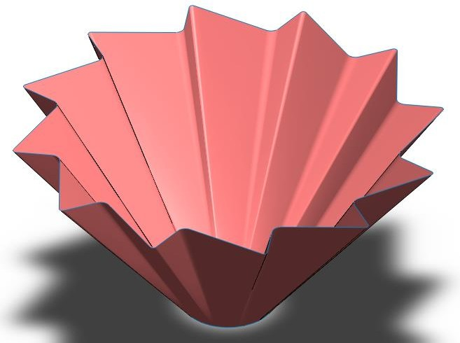
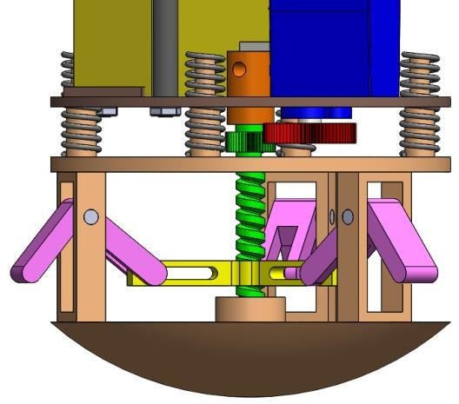
System Level CanSat Configuration Trade & Selection
Team Logo
Here
(If You Want)
CONCEPT 2
Heat shield released via a solenoid and is aided with springs
Sliding bell crank mechanism driven by lead screw to deploy the heat shield
Egg protected within a pivoting container
Origami spiral folded heat shield
Presenter: Lawrence Allegranza France (LAF)
12

Slide 13
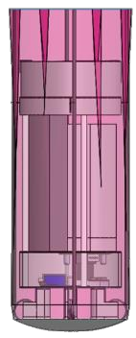
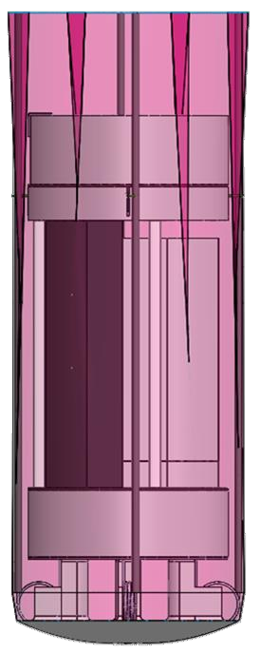
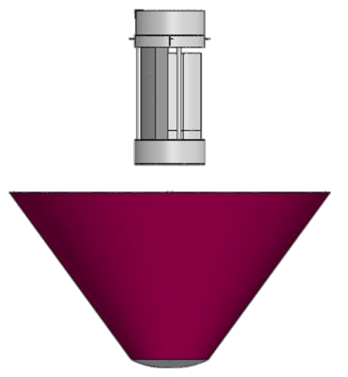
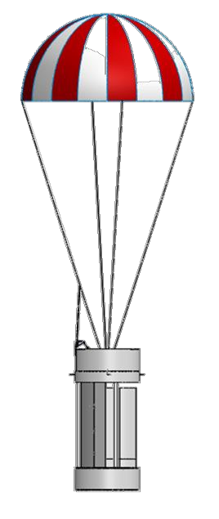
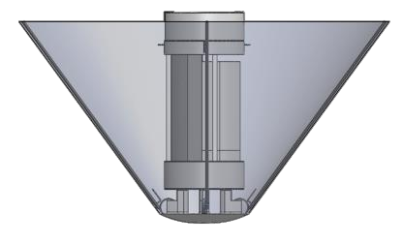

Physical Layout
Team Logo
Here
(If You Want)
1
CONCEPT 1
(Chosen)
3
4
2
Launch configuration
Deployed configuration
Released configuration of probe and heat shield
Released configuration with parachute deployed
Red – Parachute Bay Green – Deployment Bay Yellow – Electronics Bay
Light Blue – Egg Container Bay Dark Blue – Camera/Release Bay
Presenter: Lawrence Allegranza France (LAF)
13

Slide 14
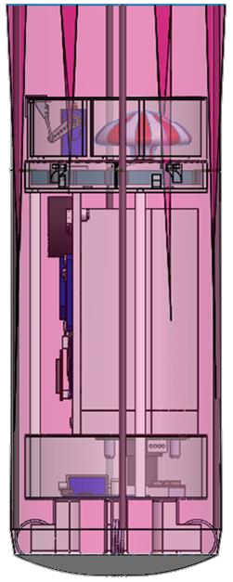
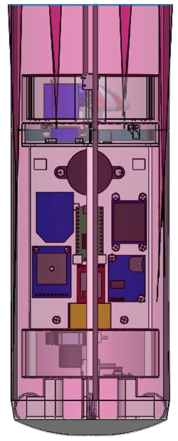
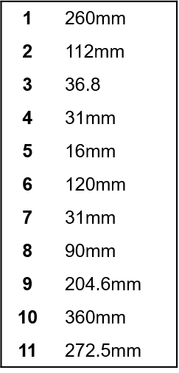
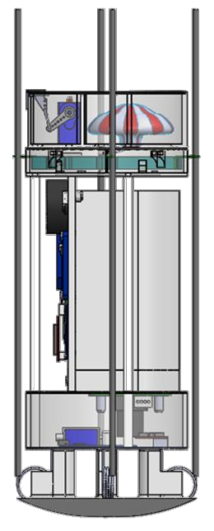
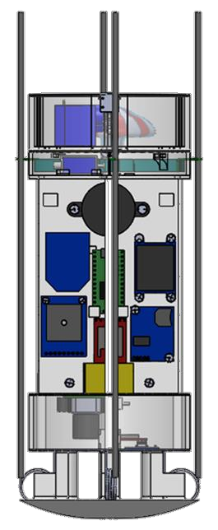
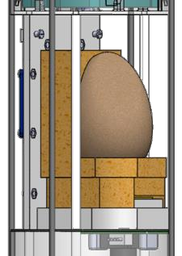
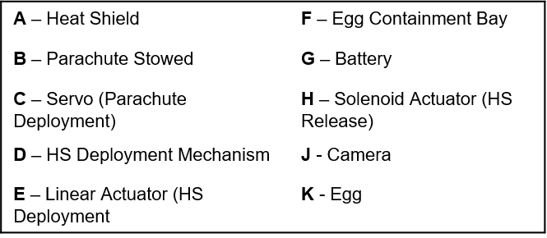
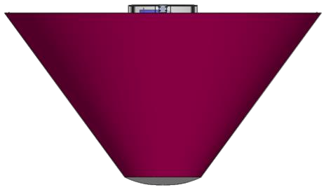
Physical Layout
Team Logo
Here
(If You Want)
CONCEPT 1 (Chosen)
A
B
C
D E
4
5
11
F
1
G
2
6
8
J
H
7
3
8
10
K
9
11
Presenter: Lawrence Allegranza France (LAF)
14

Slide 15
System Concept of Operations
Team Logo
Here
(If You Want)
0. Pre -
Launch
1. Launch
2. HS Deployment
3. CanSat Descent
4.1. HS Release
4.2.
Parachute Deployment
5. Probe Descent
6. Landing
7. Recovery
8. Data
Handover
Presenter: Lawrence Allegranza France (LAF)
15

Slide 16
System Concept of Operations
Team Logo
Here
(If You Want)
0. Pre - Launch
1. Launch
2. HS Deployment
3. CanSat Descent
4.1. HS Release
CanSat Switched on
CanSat insertion in Rocket Payload Bay
Rocket and nose cone separation
CanSat descent with Heatshield deployed
300 m altitude sensed by Probe
Telemetry transmitting start
CanSat deployed from rocket Payload Bay
HS released
Rocket ignition and ascension
Release captured
by Camera
Apogee Reached
HS deploys
Rocket and nose cone descent
Presenter: Lawrence Allegranza France (LAF)
16

Slide 17
System Concept of Operations
Team Logo
Here
(If You Want)
4.2.
Parachute Deployment
300 m altitude sensed by Probe
5. Probe Descent
8. Data Handover
6. Landing
7. Recovery
Probe descent with Parachute
Telemetry transmitting Stop
Audio Beacon Operational
Data formatted and saved to USB
HS tumble down on its own
All systems recovered (including HS)
Parachute deployed
Audio Beacon Activation
USB handed over to officials
Descent captured by Camera
CanSat switched off
Presenter: Lawrence Allegranza France (LAF)
17

Slide 18

Launch Vehicle Compatibility
Team Logo
Here
(If You Want)
19x5 mm clearance
Available Volume (as per Competition Requirements):
Diameter 125 mm
Height 310 mm
CanSat Volume:
Diameter 115 mm
Height 272 mm
Clearance 5 mm
No sharp protrusions
Dimensions account for ease of fit and deployment.
A test launch will be performed at the University of Manchester to verify Launch Vehicle Compatibility.
19x5 mm clearance
Presenter: Lawrence Allegranza France (LAF)
18

Slide 19
Sensor Subsystem Design
Team Logo
Here
(If You Want)
Team Logo
Here
Presenter Iuliu Ardelean (IA)
CanSat 2017 PDR: Team 5002 Manchester CanSat Project
19

Slide 20




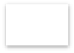
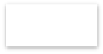











Sensor Subsystem Overview
Team Logo
Here
(If You Want)
Selected Component | Function
Adafruit 10 DOF IMU | Determine Pressure, Temperature (hence Altitude) and Tilt.
Adafruit Ultimate GPS v3.0 | Determine GPS Position
Camera | Serial JPEG TTL Camera
Microcontroller (Teensy)
 | I2C |  | Serial
Microcontroller (Nano)
Serial
Adafruit 10 DOF IMU
Adafruit Ultimate GPS
Camera
Presenter: Iuliu Ardelean (IA)

Slide 21
Sensor Subsystem Requirements
Team Logo
Here
(If You Want)
RE# | Description | VERIFICATION
 |  | A | I | T | D
RE1 | Total mass of the CanSat (probe) shall be 500 grams +/- 10 grams. |  |  |  | X
RE6 | The probe with the aero-braking heat shield shall fit in a cylindrical envelope of 125 mm diameter x 310 mm length. Tolerances are to be included to facilitate container deployment from the rocket fairing. |  |  |  | X
RE15 | The probe shall release a parachute at 300 meters. | X |  | X
RE18 | All electronic components shall be enclosed and shielded from the environment with the exception of sensors. |  | X
RE21 | All electronics shall be hard mounted using proper mounts such as standoffs, screws, or high performance adhesives. |  | X
RE25 | During descent, the probe shall collect air pressure, outside air temperature, GPS position and battery voltage once per second and time tag the data with mission time. | X | X |  | X
RE31 | Cost of the CanSat shall be under $1000. Ground support and analysis tools are not included in the cost. | X
RE46 | Battery source may be alkaline, Ni-Cad, Ni-MH or Lithium. Lithium polymer batteries are not allowed. Lithium cells must be manufactured with a metal package similar to 18650 cells. |  | X
RE49 | A tilt sensor shall be used to verify the stability of the probe during descent with the heat shield deployed and be part of the telemetry. |  | X |  | X
B1 | Video Camera | X |  | X
B2 | Wind sensor | X |  | X
SE1 | Pressure Sensor should be accurate. |  |  | X
Presenter: Iuliu Ardelean (IA)

Slide 22




Probe Air Pressure Sensor Trade & Selection
Team Logo
Here
(If You Want)
Name | Weight/ Size | Cost | Power | Operational Environment | Accuracy /Error | Resolution | Drift | Interface | Other
MPL 3115 A2 | 1.2 g | 10 GBP | 2 mA x 3.6 V | 50 – 110 kPa | 50 Pa | 1.5 Pa | 100 Pa/yr | I2C
 | 18x19x2 mm |  | 8.5-265 uA x 3.6V | 5000 to -500 m | 3 m | 0.3 m
BMP 180 | 4g | 10 GBP | 1 mA x 3.6V | 30 – 110 kPa | 12 Pa | 2-6 Pa | 100 Pa/yr | I2C
 | - |  | 3-32 uA x 3.6V | 9000 to – 500 m | 1 m | 0.17-0.5 m
Adrafruit 10 DOF IMU | 2.8 g | 10 GBP | 1 mA x 3.6 V | 30 – 110 kPa | 12 Pa | 2-6 Pa | 100 Pa/yr | I2C | All in one
 | 38x23x3 mm |  | 3-32 uA x 3.6 V | 9000 to – 500 m | 1 m | 0.17-0.5 m
Selected | Rationale
Adafruit 10 DOF IMU | All in one, Accuracy/Error
Presenter: Iuliu Ardelean (IA)

Slide 23


Probe Air Temperature Sensor Trade & Selection
Team Logo
Here
(If You Want)
Name | Weight/Size | Cost | Power | Operational Environment | Accuracy /Error | Interface | Other
TMP 36 | Lightweight | 1 GBP | 50 uA x 5.5V | -40 – 125 degC | 2 degC | Analog
 | Small |  | Low
MPL 3115 A2 | 1.2 g | 10 GBP | 2 mA x 3.6 V | -40 – 85 degC | 3 degC | I2C
 | 18x19x2 mm |  | 8.5 – 265 uA x 3.6V
BMP 180 | 4g | 10 GBP | 1 mA x 3.6V | -40 – 85 degC (0 - 65 full accuracy) | 2 degC | I2C
 | - |  | 3 – 32 uA x 3.6V
Adrafruit 10 DOF IMU | 2.8 g | 10 GBP | 1 mA x 3.6 V | -40 – 85 degC (0 - 65 full accuracy) | 2 degC | I2C | All in one
 | 38x23x3 mm |  | 3 – 32 uA x 3.6 V
Selected | Rationale
Adafruit 10 DOF IMU | All in one, Accuracy/Error
Presenter: Iuliu Ardelean (IA)

Slide 24


GPS Sensor Trade & Selection
Team Logo
Here
(If You Want)
Component | Weight/Size | Cost | Power | Operational Environment | Accuracy/ Error | Interface | Other
Adafruit Ultimate GPS Breakout | 8.5g | 40 GBP | 20mA x 3.3V | 515 m/s | 3 meters | Serial | Warm/cold start: 34 seconds
 | 25.5mm x 35mm x 6.5mm
SparkFun Venus GPS Breakout | 8 g | 40 GBP | 30 mA x 3.3V | 515 m/s | 2.5 meters | Serial, I2C | Warm/cold start: 29 seconds
 | 30 mm x 18 mm x 14 mm
Selected | Rationale
Adafruit Ultimate GPS Breakout | Power
Presenter: Iuliu Ardelean (IA)

Slide 25


Probe Power Voltage Sensor Trade & Selection
Team Logo
Here
(If You Want)
Name | Weight/Size | Cost | Power | Operational Environment | Accuracy/ Error | Interface | Other
INA219 | (?) | 20 GBP | 1 mA x 5.5V | 0 – 26 V | 0.5% | I2C
 | 23 x 20 mm
Onboard AD Converter | Negligible | Low | Low | Any |  | Analog | Simplicity
 | Negligible
Selected | Rationale
Onboard ADC | Simplicity, Ease of Use
Presenter: Iuliu Ardelean (IA)

Slide 26



Tilt Sensor Sensor Trade & Selection
Team Logo
Here
(If You Want)
Name | Weight/Size | Cost | Power | Operational Environment | Accuracy/ Error | Interface | Other
Adafruit Tilt Sensor | 1 g | 2 GBP | 6mA x 24 V | 0-30 | 30 deg | Analog | Need 2 of them
 | 4x4x12 mm
Adrafruit 10 DOF IMU | 2.8 g | 10 GBP | 1 mA x 3.6 V | 0-360 | Variable | I2C | All in One
 | 38x23x3 mm |  | 3-32 uA x 3.6 V
NOTE: As per Competition Guidelines, tumbling is defined as end over end rotation.
Selected | Rationale
Adafruit 10 DOF IMU | All in one
Presenter: Iuliu Ardelean (IA)

Slide 27




Bonus Camera Trade & Selection
Team Logo
Here
(If You Want)
Name | Weight/Size | Cost | Power | Resolution | FPS | Interface
Miniature TTL Serial JPEG Camera with NTSC Video | 3 g | 36 GBP | 75 mA x 5 V | 640 x 480 | 30 | 3.3V TTL
 | 20x28 mm
Pixy CMUCam5 | 25.5 g | 70 GBP | 140 mA x 5 V | 1280 x 800 | 50 | I2C, SPI, UART
 | 50x54 mm
Selected | Rationale
Miniature TTL Serial JPEG Camera with NTSC Video | Power, Previous Experience
Presenter: Iuliu Ardelean (IA)

Slide 28
Bonus Wind Sensor
Team Logo
Here
(If You Want)
Ideas Considered | Brief Description | Advantages | Disadvantages
Differential Pressure Sensor | Using differential pressure sensors on sides of Can Sat to read pressure, which is used to calculate wind speed | Relatively light sensors Wind direction could also be calculated, if necessary. | More data inputs required on microprocessor Somewhat complex calculations Too many external influences
GPS Coordinates | Using x and y GPS coordinates to determine change in probe location and therefore wind speed. | No extra weight of sensors; only VCO, DAC, filter, and antenna Easier determination of wind direction, if necessary. Good GPS accuracy | Must take into consideration effect of mass of CanSat May be influenced by inconsistencies due to parachute design (can be negligible)
Final Decision | Rationale
GPS Coordinates | Use what is already available Least complexity Least weight Reliable accuracy
Presenter: Iuliu Ardelean (IA)
28

Slide 29
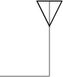
Bonus Wind Sensor
Team Logo
Here
(If You Want)
Microprocessor already gathers GPS coordinates; it can use Pythagorean theorem
on x & y coordinates for every reading and calculate the wind speed
VCO designed from discrete components, as a single transistor-based oscillator circuit (FM transmitter).
Oscillator frequency (one of 8 channels) is dependent on LC tank of oscillator circuit
–Inductance value is constant
–Capacitance value determined by varactor diode
Varactor diode has voltage applied (provided by microprocessor); voltage will be adjusted in the code according to the channel desired (Teensy can be reprogrammed within CanSat, on ground)
Also considered simple voltage divider circuit with potentiometer to be adjusted on ground instead
Microprocessor outputs a PWM signal (tone) to the VCO according to the wind speed calculated (1 Hz per 0.1 m/s). This adjusts signal.
DAC
Teensy
3.2 A
GPS
Voltage Controller Oscillator
Buffer (Emitter Follower)
ISM Band Antenna
Presenter: Iuliu Ardelean (IA)

Slide 30
Bonus Wind Sensor
Team Logo
Here
(If You Want)
The wind speed signal is frequency modulated. Therefore, an FM receiver operational from 433 - 434 MHz is required on the ground station.
Receiver | Cost | Frequency | Advantages | Disadvantages
Team-designed using Discrete Components | ~£2 (discrete components) | 433 – 434 MHz (Determined by LC tank of oscillator) | Better understanding Simple is better (one transistor based circuit) | A lot of circuit prototyping required (breadboards at high frequencies not great)
RFM01 ISM Band FSK Receiver | £2.16 | 430.24 – 439.75 MHz | No designing needed Allows for the use of multiple channels in any of the bands. | No extensive data sheet info to work with Adjustments needed (FSK not used)
Device Chosen | Rationale
Team-designed Receiver | Simplicity Thorough troubleshooting and understanding Low weight
FCC Compliance: Regulation 10CFR47 Part 15.231
Presenter: Iuliu Ardelean (IA)

Slide 31
Team Logo
Here
(If You Want)
Team Logo
Here
Descent Control Design
Presenter Iuliu Ardelean (IA)
CanSat 2017 PDR: Team 5002 Manchester CanSat Project
31

Slide 32
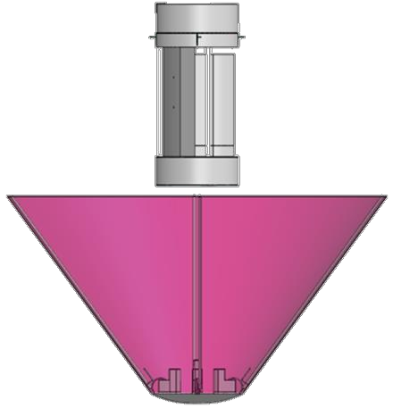
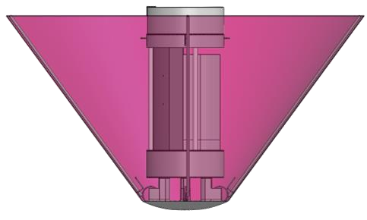
Descent Control Overview
Team Logo
Here
(If You Want)
Descent Control System
Consists of a parachute and a heat shield with adjustable deployment size depending on weather conditions and no openings.
Deployment and release order
Probe is deployed at altitude of 675-725 meters and the aero breaking covering the whole probe shield opens which results in descent rate being kept at 10-30 m/s
At 300 meters heat shield is released; the deployment of parachute follows immediately
The descent rate is decreased to 5 m/s which is slow enough for the egg to remain intact after landing
Heat shield projected surface area | 0.164 𝑚²
Parachute projected surface area | 0.233 𝑚²
2nd stage – 300 m to Landing
1st stage – Apogee to 300 m
2nd event – release 3rd event – deployment of the heat shield of the parachute
1st event – deployment of the heat shield
Presenter: Iuliu Ardelean (IA)

Slide 33
Descent Control Requirements
Team Logo
Here
(If You Want)
RE# | Description | VERIFICATION
 |  | A | I | T | D
RE1 | Total mass of the CanSat (probe) shall be 500 grams +/- 10 grams. |  |  |  | X
RE2 | The aero-braking heat shield shall be used to protect the probe while in the rocket only and when deployed from the rocket. It shall envelope/shield the whole sides of the probe when in the stowed configuration in the rocket. The rear end of the probe can be open |  | X |  | X
RE3 | The heat shield must not have any openings. |  | X
RE4 | The probe must maintain its heat shield orientation in the direction of descent. |  | X
RE5 | The probe shall not tumble during any portion of descent. Tumbling is rotating end-over-end. | X |  | X
RE6 | The probe with the aero-braking heat shield shall fit in a cylindrical envelope of 125mm diameter x 310mm length. Tolerances are included to facilitate container deployment from the rocket fairing. |  |  |  | x
RE9 | The aero-braking heat shield shall not have any sharp edges to cause it to get stuck in the rocket payload section which is made of cardboard. |  |  |  | X
RE10 | The aero-braking heat shield shall be a florescent color; pink or orange. | X | X
RE11 | The rocket airframe shall not be used to restrain any deployable parts of the CanSat. | X |  |  | X
RE12 | The rocket airframe shall not be used as part of the CanSat operations. | X |  |  | X
RE13 | The CanSat, probe with heat shield attached shall deploy from the rocket payload section. |  |  | X
RE14 | The aero-braking heat shield shall be released from the probe at 300m. | X |  | X
RE15 | The probe shall release a parachute at 300m. | X |  | X
RE16 | All descent control device attachment components (aero-braking heat shield and parachute) shall survive 30Gs of shock. | X |  | X
Presenter: Iuliu Ardelean (IA)

Slide 34
Descent Control Requirements
Team Logo
Here
(If You Want)
RE# | Description | VERIFICATION
 |  | A | I | T | D
RE17 | All descent control devices (aero-braking heat shield and parachute) shall survive 30Gs of shock. | X |  | X
RE18 | All electronic components shall be enclosed and shielded from the environment with the exception of sensors. |  | X
RE19 | All structures shall be built to survive 15Gs of launch acceleration. | X |  | X
RE20 | All structures shall be built to survive 30Gs of shock. | X |  | X
RE31 | Cost of the CanSat shall be under $1000. Ground support and analysis tools are not included in the cost. | X
RE38 | Both the heat shield and probe shall be labelled with team contact information including email address. |  |  |  | X
RE43 | The descent rate of the probe with the heat shield deployed shall be between 10 and 30 meters/second. | X |  | X
RE44 | The descent rate of the probe with the heat shield released and parachute deployed shall be 5 meters/second. | X |  | X
RE44 | The descent rate of the probe with the heat shield released and parachute deployed shall be 5 meters/second. | X |  | X
Presenter: Iuliu Ardelean (IA)

Slide 35
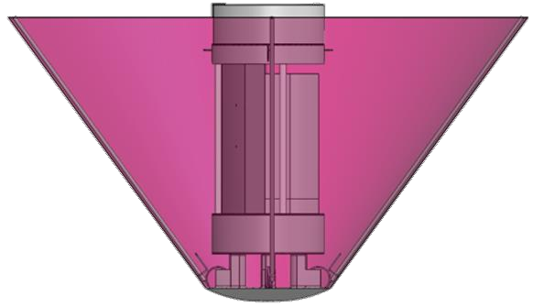



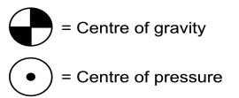
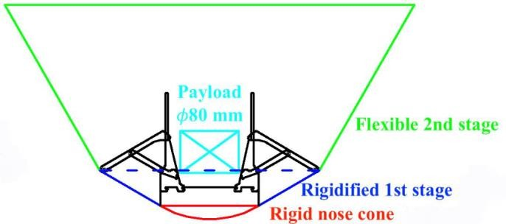
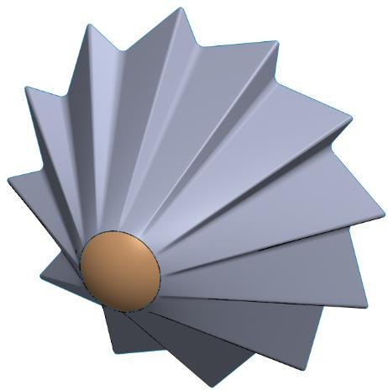
Descent Stability Control Strategy Selection and Trade
Team Logo
Here
(If You Want)
The heat shield uses a passive design as it saves weight and simplifies the system
The heat shield forms a squared opening thus acting like a finned design. This prevents any kind of tumbling and maintains a straight trajectory
A passive design is at mercy of the wind so nadir direction is not maintained well however maintaining nadir direction comes at the expense of weight which is limited.
The centre of gravity is below the centre of pressure which gives it aerodynamic stability.
Current Design
Current Design chosen due to lighter mass and less volume.
Alternative Design
The flexible stage has grooves running through, creating a spin which maintains the nadir direction.
The deployment mechanism is heavier. This design is much more complex to construct and deploy. It is much more difficult to detach the heat shield
Although an active system could have been created however the mechanical complexity adds a great risk of failure for very little advantage and the flight time is very short, thus a passive system is better.
Presenter: Iuliu Ardelean (IA)

Slide 36
Descent Rate Estimates
Team Logo
Here
(If You Want)
Formulae used for Numerical Estimates:
𝟏
𝟐
1. 𝑾 = 𝑫 = _{𝟐} 𝝆𝒗 𝑪_{𝑫}𝑺
𝑫 – drag force acting on the probe
𝑊 – weight of CanSat/Probe
𝝆 – air density
𝒗 – terminal velocity
𝑪_{𝑫} – drag coefficient
𝑺 – projected surface area of descending object
2. 𝑺 = 𝝅𝒓^{𝟐} ⟶ 𝒓 =
𝟐𝑫
𝒓 – radius of projected surface area
𝝆𝑪_{𝑫}𝝅𝒗^{𝟐}
Presenter: Iuliu Ardelean (IA)

Slide 37
Descent Rate Estimates
Team Logo
Here
(If You Want)
Assumptions:
Weight of the falling object is equal to drag when it travels with constant velocity (terminal velocity),
Density of air is assumed to be 1.2 ^{𝑘𝑔} ,
_{𝑚}3
No wind or air currents (depending on weather conditions the heat shield size can be adjusted).
1. 𝒎_{𝟏} = 𝟎. 𝟓 𝒌𝒈
2. 𝒎_{𝟐} = 𝟎. 𝟒 𝒌𝒈
3. 𝝅 = 𝟑. 𝟏𝟒𝟏𝟓
𝒎_{𝟏}- mass of the probe (CanSat + heat shield + parachute)
𝒎_{𝟐}- mass of CanSat and parachute
𝒈- gravitational acceleration
4. 𝒈 = 𝟗. 𝟖𝟏 ^{𝒎}
_{𝒔}𝟐
𝑪_{𝑫𝒑}- drag coefficient of parachute
𝑪_{𝑫𝒉𝒔}- drag coefficient of heat shield
Outputs:
𝑺_{𝒑}- area of the parachute with a spill hole
𝒓_{𝒉𝒔}- radius of heat shield
the heat shield envelopes the probe completely to protect it
Presenter: Iuliu Ardelean (IA)

Slide 38
Descent Rate Estimates
Team Logo
Here
(If You Want)
Heat shield calculations Parachute calculations
Estimated drag coefficient (𝑪_{𝑫𝒉𝒔})*: 0.55
Estimated drag coefficient (𝑪_{𝑫𝒑}): 1.124
𝒎
𝒔
Required velocity (𝒗 ): 5 ^{𝒎}
𝒎
𝟐
𝒔
𝟏𝟎 < 𝒗 < 𝟑𝟎
𝒔
𝟐𝒎_{𝟐}𝒈
𝑺 =
= 𝟎. 𝟐𝟑𝟑𝒎^{𝟐}
𝒑
𝝆𝒗^{𝟐}𝑪_{𝑫𝒑}
𝟐 · 𝒎_{𝟏} · 𝒈
< 𝒓 <
𝟐 · 𝒎_{𝟏} · 𝒈
𝝆 · 𝑪_{𝑫𝒉𝒔} · 𝝅 · 𝟏𝟎^{𝟐}
𝒉𝒔
𝝆 · 𝑪_{𝑫𝒉𝒔} · 𝝅 · 𝟑𝟎^{𝟐}
Area of the spill hole is chosen to be 3%
of the total parachute projected area
𝟎. 𝟐𝟏𝟖 𝒎 < 𝒓_{𝒉𝒔} < 𝟎. 𝟎𝟕𝟑 𝒎
Chosen radius: 0.11 m
Projected area of parachute without the spill hole: 0.233 × 103% = 𝟎. 𝟐𝟒𝟎𝒎^{𝟐}
* Estimates based on drag coefficients of the hemisphere and cone
Presenter: Iuliu Ardelean (IA)

Slide 39
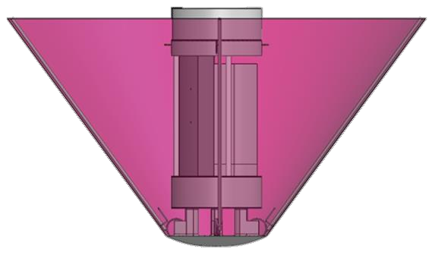
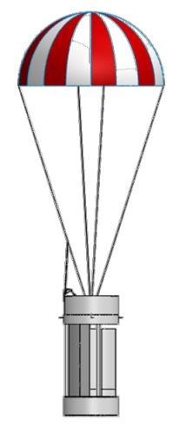
Descent Rate Estimates
Team Logo
Here
(If You Want)
Estimation of velocity for CanSat with stowed parachute and deployed probe
2 · 𝑚₁ · 𝑔
𝑚
= 19.77
𝑣 =
1
𝜌 · 𝐶_{𝐷ℎ𝑠} · 𝜋 · 𝑟²
𝑠
ℎ𝑠
Estimation of velocity for CanSat with deployed parachute
2 · 𝑚₂ · 𝑔
𝑚
= 5
𝑣 =
2
𝜌 · 𝐶_{𝐷𝑝} · 𝑆_{𝑝}
𝑠
Presenter: Iuliu Ardelean (IA)

Slide 40
Mechanical Subsystem Design
Team Logo
Here
(If You Want)
Team Logo
Here
Presenter
Lawrence Allegranza France (LAF)

Slide 41
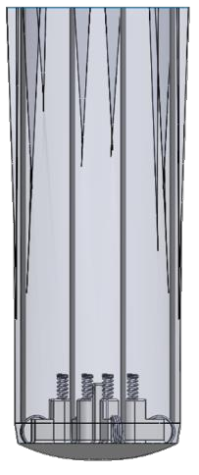
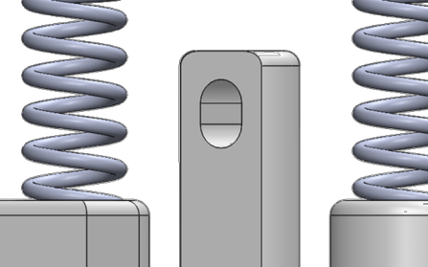

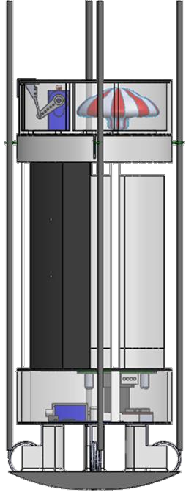
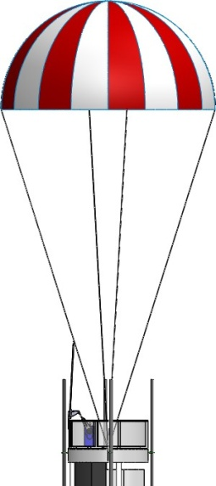
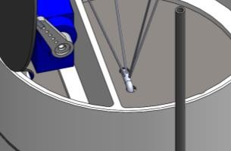
Mechanical Subsystem Overview
Team Logo
Here
(If You Want)
Key Aspects & Materials
Heat Shield
Nylon Heat Shield
Deployment Bay (PLA)
Parachute Bay (PLA)
Heat Shield is attached via a solenoid rod extending through a hole at the top of the nose cone. Once the solenoid retracts it’s rod, the heat shield releases from the probe.
Nylon Rods
272 mm
Carbon Fibre Rod
Egg Container (PLA)
Probe
Once the heat shield is released, the parachute deploys from its bay. The parachute is held to the probe via two holes in the parachute bay plate.
Camera Bay (PLA)
Nose Cone (PLA)
115mm
Presenter: Lawrence Allegranza France (LAF)

Slide 42
Mechanical Sub-System Requirements
Team Logo
Here
(If You Want)
RE# | Description | VERIFICATION
 |  | A | I | T | D
RE1 | Total mass of the CanSat (probe) shall be 500 grams +/- 10 grams. |  |  |  | X
RE2 | The aero-braking heat shield shall be used to protect the probe while in the rocket only and when deployed from the rocket. It shall envelope/shield the whole sides of the probe when in the stowed configuration in the rocket. The rear end of the probe can be open |  | X |  | X
RE3 | The heat shield must not have any openings. |  | X
RE6 | The probe with the aero-braking heat shield shall fit in a cylindrical envelope of 125mm diameter x 310mm length. Tolerances are included to facilitate container deployment from the rocket fairing. |  |  |  | x
RE7 | The probe shall hold a large hen’s egg and protect it from damage from launch until landing. |  |  | X | X
RE8 | The probe shall accommodate a large hen’s egg with a mass ranging from 54 grams to 68 grams and a diameter of up to 50mm and a length of up to 70mm. |  |  |  | X
RE9 | The aero-braking heat shield shall not have any sharp edges to cause it to get stuck in the rocket payload section which is made of cardboard. |  |  |  | X
RE10 | The aero-braking heat shield shall be a florescent color; pink or orange. | X | X
RE11 | The rocket airframe shall not be used to restrain any deployable parts of the CanSat. | X |  |  | X
RE12 | The rocket airframe shall not be used as part of the CanSat operations. | X |  |  | X
RE13 | The CanSat, probe with heat shield attached shall deploy from the rocket payload section. |  |  | X
RE14 | The aero-braking heat shield shall be released from the probe at 300m. | X |  | X
RE15 | The probe shall release a parachute at 300m. | X |  | X
RE16 | All descent control device attachment components (aero-braking heat shield and parachute) shall survive 30Gs of shock. | X |  | X
RE17 | All descent control devices (aero-braking heat shield and parachute) shall survive 30Gs of shock. | X |  | X
Presenter: Lawrence Allegranza France (LAF)

Slide 43
Mechanical Sub-System Requirements
Team Logo
Here
(If You Want)
Team Logo
Here
RE# | Description | VERIFICATION
 |  | A | I | T | D
RE18 | All electronic components shall be enclosed and shielded from the environment with the exception of sensors. |  | X
RE19 | All structures shall be built to survive 15Gs of launch acceleration. | X |  | X
RE20 | All structures shall be built to survive 30Gs of shock. | X |  | X
RE21 | All electronics shall be hard-mounted using proper mounts such as standoffs, screws, or high performance adhesives. |  | X
RE22 | All mechanisms shall be capable of maintaining their configuration or states under all forces. |  |  | X
RE23 | Mechanisms shall not use pyrotechnics or chemicals. | X
RE24 | Mechanisms that use heat (e.g. nichrome wire) shall not be exposed to the outside environment to reduce potential risk of setting vegetation on fire. | X |  |  | X
RE31 | Cost of the CanSat shall be under $1000. Ground support and analysis tools are not included in the cost. | X
RE38 | Both the heat shield and probe shall be labelled with team contact information including email address. |  |  |  | X
RE40 | No lasers allowed. | X |  |  | X
RE41 | The probe must include an easily accessible power switch. | X |  |  | X
RE42 | The probe must include a power indicator such as an LED or sound generating device. |  | X |  | X
RE47 | An easily accessible battery compartment must be included allowing batteries to be installed or removed in less than a minute and not require a total disassembly of the CanSat. | X |  |  | X
B1 | Camera: Add a colour video camera to capture the release of the heat shield and the ground during the last 300 meters of descent; the camera must have a resolution of at least 640x480 and a frame rate of at least 30 frames/sec | X |  | X
Presenter: Lawrence Allegranza France (LAF)

Slide 44
Probe Mechanical Layout of Components Trade & Selection
Team Logo
Here
(If You Want)
The following page discusses the structure materials for the probe.
Structure Materials
 | Method | Density | Manufacturing | Advantages | Disadvantages
End Plates | Carbon Fibre | 1280kg/m³ | CNC, (BOS) | Lightweight, very strong | Time consuming
 | Balsa Wood | 170kg/m³ | Laser Cutter | Extremely lightweight | Low strength
 | Pine Plywood | 575kg/m³ | Laser Cutter | Extremely lightweight | Low strength
Main Parts | PLA (3D Printed) | 1430kg/m³ | 3D Printer | Very strong, easy to shape | Heavy
 | ABS (3D Printed) | 1052kg/m³ | 3D Printer | Very strong, easy to shape | Heavy
 | Nylon Pipe (Spacers) | 1150kg/m³ | Cutting to Size (BOS) | Lightweight | Light sensitivity
 | PVC Tubing | 1375kg/m³ | Cutting to Size (BOS) | Strong | Difficult to customise
 | Fibreglass | 1522kg/m³ | CNC (BOS) | Strong | Hard to machine, heavy
Presenter: Lawrence Allegranza France (LAF)

Slide 45
Probe Mechanical Layout of Components Trade & Selection
Team Logo
Here
(If You Want)
The following page discusses the mechanisms for the probe.
Mechanisms
 | Method | Mass | Reliability | Advantages | Disadvantages
Parachute Release Door | Servo | 9g | Off the Shelf | Able to control in small steps | Large space required
 | Solenoid | 12.6g | Reliable | High performance | Short travel range
 | Spring Loaded | TBD | Very Reliable | Able to calculate | Needs additional structure mass
Heat Shield Release | Solenoid | 12.6g | Reliable | High performance | Short travel range
 | Servo & Rod | ~11g | Off the Shelf | Able to control in small steps | Large space required
 | Spring Loaded | TBD | Very Reliable | Able to calculate | Needs additional structure mass
 | Nichrome Wire | TBD | Reliable | Very lightweight | Non-reusable
Heat Shield Deployment | Spring Loaded | TBD | Very Reliable | Able to calculate | Needs additional structure mass
 | System of Rods | TBD | Reliable | Very strong | Very heavy
 | Linear Actuator | TBD | Very reliable | Very strong | Heavy
Presenter: Lawrence Allegranza France (LAF)

Slide 46
Probe Mechanical Layout of Components Trade & Selection
Team Logo
Here
(If You Want)
Chosen Mechanisms
 | Method | Rationale
Parachute Release Door | Servo & Spring Loaded | The combination of these two methods combines reliability and strength.
Heat Shield Release | Solenoid & Spring Loaded | The combination of these two methods combines reliability and strength. A solenoid is used instead of a servo for increased reliability.
Heat Shield Deployment | Linear Actuator & Spring Loaded | A linear actuator is used instead of a servo for increased reliability.
Structure Materials
 | Method | Rationale
End Plates | Carbon Fibre | Very lightweight and doesn’t require much room as it can be bought in 1mm thick sheets.
Main Parts | PLA (3D Printed) | High strength and easy to remodel and print on 3D printers.
 | Nylon Pipe | High strength and lightweight method for jointing end plates.
Chosen Structure Designs
Method | Rationale
Layout 1 | This design was chosen as it offers the best layout as it uses the method of stacking the bays. This saves space.
Presenter: Lawrence Allegranza France (LAF)

Slide 47
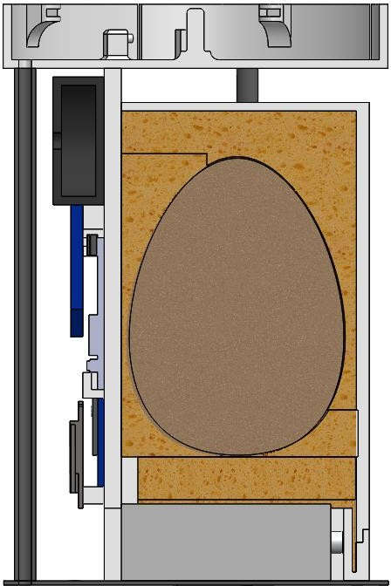
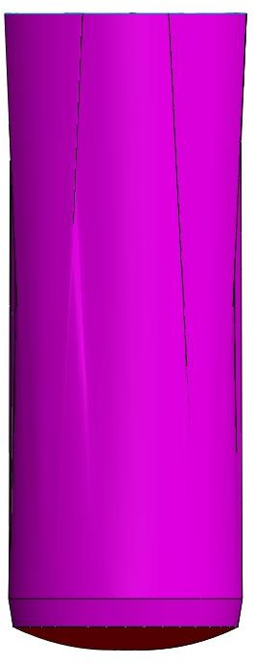
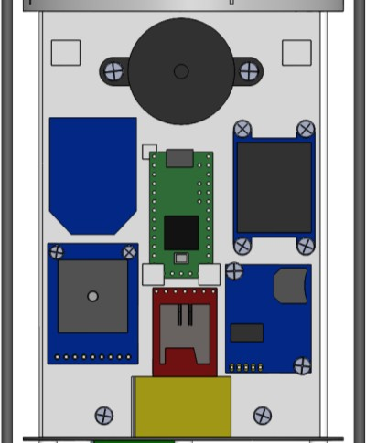
Probe Mechanical Layout of Components Trade & Selection
Team Logo
Here
(If You Want)
The two following pages discusses the first method conceptualised for the mechanical layout of components.
Layout 1
Carbon Fibre Rods
Rocket Body Tube
Egg Cover Sponge
Egg Holding Sponge
Heat Shield
Pre-Deployment
Parachute Bay
Nylon Rod
Heat Shield Deployment Bay
Battery Sponge
Electronics Cover
Electronic
Components
Egg Protection Container
Battery
Camera Bay
Presenter: Name goes here
CanSat 2017 PDR: Team ### (Team Number and Name)

Slide 48
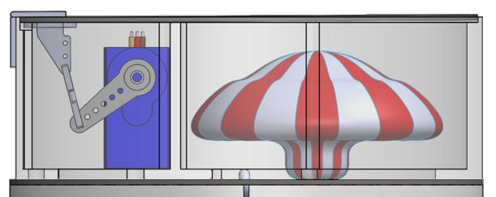
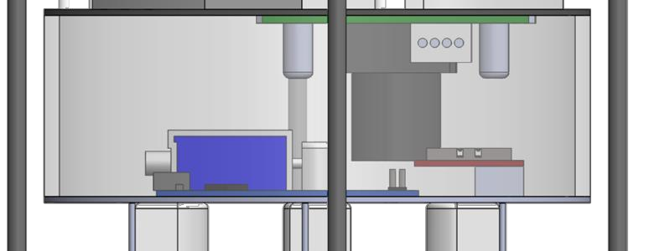
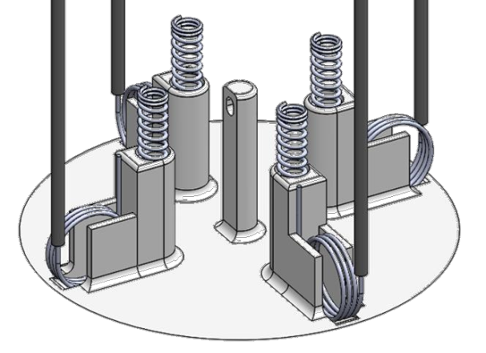
Probe Mechanical Layout of Components Trade & Selection
Team Logo
Here
(If You Want)
The two following pages discusses the two methods conceptualised for the mechanical layout of components.
Layout 1
Camera
Parachute Stowed by folding
Parachute held via rope
Control Rod & Control Horn
Servo
Solenoid
Heat Shield Attachment Point
Key Features:
Compression springs ensure smooth transition for heat shield release
Very compact
Advantages:
Easy access to egg, battery and electronics
Egg has a lot of protection
Disadvantages:
Close to mass budget
Has many delicate parts
Tension Springs
Compression Springs
Presenter: Name goes here
CanSat 2017 PDR: Team ### (Team Number and Name)

Slide 49
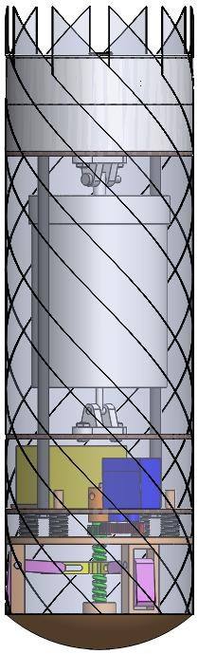
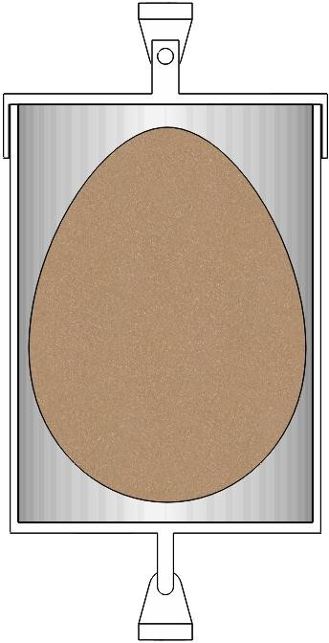
Probe Mechanical Layout of Components Trade & Selection
Team Logo
Here
(If You Want)
The three following pages discusses the second method conceptualised for the mechanical layout of components. This method works through the design depicted on slide 32.
Layout 2
Rocket Body
Tube
Parachute Bay
Locking Pin
Electronics Bay
Egg
Payload Bay
Battery Bay
Carbon Fibre Plates
Battery
Protection
Structure Pivot
Heat Shield Deployment/ Release Bay
Origami spiral folded heat shield
Presenter: Name goes here
CanSat 2017 PDR: Team ### (Team Number and Name)

Slide 50
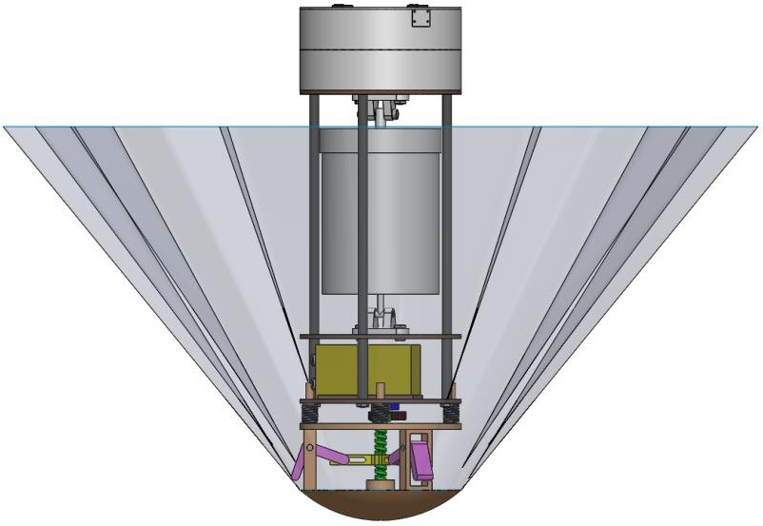
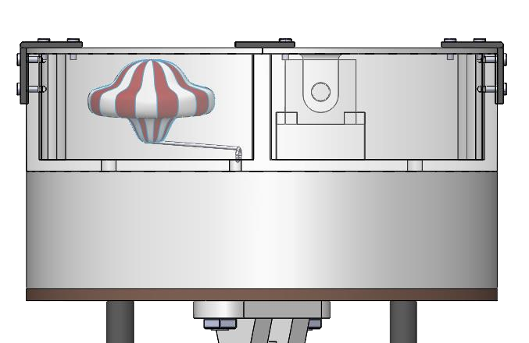

Probe Mechanical Layout of Components Trade & Selection
Team Logo
Here
(If You Want)
Layout 2
Parachute Stowed
by folding
Double doors
Solenoid
Heat Shield Deployed View
Heat Shield Base
Compression Springs x 4
Compression Springs x 2
Doors opened for parachute release
Retaining hole for solenoid
Presenter: Name goes here
CanSat 2017 PDR: Team ### (Team Number and Name)

Slide 51



Probe Mechanical Layout of Components Trade & Selection
Team Logo
Here
(If You Want)
Layout 2
Solenoid retracts to release heat shield
Servo gear turns axial rod to deploy heat shield
Heat Shield attachment point
Springs for helping release go smoothly
Sliding bell cranks for deploying HS
Key Features: Dedicated space for each category of parts Spring-loaded actuations, Solenoid trigger
Advantages: Not many moving parts
Disadvantages: Egg access is slightly difficult, Heavier due to arrangement and solenoids
CanSat 2017 PDR: Team ### (Team Number and Name)
52

Slide 52


Payload Pre Deployment Configuration Trade & Selection
Team Logo
Here
(If You Want)
Key trade issues
1. Spring loaded Rotating mechanism | 2. A spinning 3D printed rod extension mechanism
Lighter and requires less volume | Dynamo is heavier and requires a larger volume
Easy access and set-up; the rods can be hooked on easily | Does not need a setup procedure, however dynamo may not provide enough power for the HS to deploy fast enough.
3D printed gate has to withstand the torsional force applied by the springs as the gate is placed further up on the rods benefiting from lever action. | 3D printed system has to be sufficiently strong hence very dense and heavy in order to withstand the torque applied by the fast spinning dynamo.
2. CanSat and the heat shield are kept in stowed position by a spinning 3D printed rod extension mechanism connected to the dynamo. The HS is not going to deploy unless the power signal is received by the dynamo.
Actuator extension rotates the gate
Hooks
1. HS is kept in stowed position by a gate with rotating mechanism and hooks. Until the gate rotates, the hooks will not release and the rods will not extend under torsional force from the springs in the nose cone
Rotating gate
Design 1 was chosen because of better mass and volume
Presenter: Lawrence Allegranza France (LAF)

Slide 53
Heat shield Deployment Configuration Trade & Selection
Team Logo
Here
(If You Want)
Rotating gate
Actuator
Key trade issues
1. Spring loaded Rotating mechanism | 2. Spinning 3D printed rod extension mechanism
Simplistic design; one signal required to actuate the mechanism, less likely to fail | Complex design and software to control the speed of the dynamo and HS deployment
More reliable thanks to usage of components which are more resistant to high G forces | Less reliable; dynamo may fail due to high G forces, “Fusilli” rod likely to break under high G forces and friction.
Hooks
Chosen design
1. Signal is sent to the
2. Power is supplied to the dynamo which causes the 3D printed rod extension to rotate. This, in turn deploys the HS.
actuator that pushes the
rotating mechanism in anti- clockwise direction causing the release of the hooks
and thus, the HS; the
Design 1 was chosen because of better mass and volume
actuator is located close to the centre of plate to enable
required displacement of
the top part of rotating
mechanism.
Presenter: Lawrence Allegranza France (LAF)

Slide 54
Heat shield Mechanical Layout of Components Trade & Selection
Team Logo
Here
(If You Want)
Structure Materials
 | Material | Density | Manufacturing | Advantages | Disadvantages
Nose Cone | Carbon Fibre | 1280kg/m³ | CNC | Lightweight, very strong | Expensive, time consuming
 | Balsa Wood | 170kg/m³ | Laser Cutter | Extremely Lightweight | Low strength
 | PLA (3D Printed) | 1430kg/m³ | 3D Printed | Very strong, easy to manufacture, readily available | Heavy
Deployment Rods | Carbon Fibre | 1280kg/m³ | CNC | Lightweight, very strong | Expensive, time consuming
 | PVC Tubing | 1375kg/m³ | Cutting to Size | Strong, cheap | Difficult to customize
 | Nylon Pipe | 1150kg/m³ | Cutting to Size | Lightweight | Light sensitivity
Release Mechanism Bay | Carbon Fibre | 1280kg/m³ | CNC | Lightweight, very strong | Expensive, time consuming
 | PLA (3D Printed) | 1430kg/m³ | 3D Printed | Very strong, easy to manufacture, readily available | Heavy
 | Balsa Wood | 170kg/m³ | Laser Cutter | Extremely Lightweight | Low strength
Heat Shield | Rip-Stop Nylon | 46g/m² | Cutting to Size | Lightweight, very strong | Expensive
 | Cloth | 1000kg/m³ | Cutting to Size | Readily available, strong | Heavy
 | Paper | 1500kg/m³ | Cutting to Size | Very Lightweight | Low strength
Presenter: Lawrence Allegranza France (LAF)

Slide 55
Heat shield Mechanical Layout of Components Trade & Selection
Team Logo
Here
(If You Want)
 |  |  |  | Mechanisms
 | Component |  | Mass | Reliability | Advantages | Disadvantages
HS Deployment Mechanism | Torsion Spring Loaded |  | TBD | Very Reliable | Able to calculate | Needs additional structure mass
 | System of Rods |  | TBD | Reliable | Very strong | Very heavy
 | Linear Actuator |  | TBD | Very reliable | Very strong | Heavy
HS Release Mechanism | Solenoid |  | 12.6g | Reliable | High performance | Short travel range
 | Servo & Rod |  | ~11g | Off theShelf | Able to controlin small steps | Large space required
 | Compresion Spring Loaded |  | TBD | Very Reliable | Able to calculate | Needs additional structure mass
 | NichromeWire |  | TBD | Reliable | Very lightweight | Non-reusable
Chosen Materials
 |  | Materials |  |  | Rationale
Nose Cone |  | Carbon Fibre | Very lightweight and doesn’t require much room as it can be bought in 1mm thick sheets.
Deployment Rods |  | Carbon Fibre | High strength and lightweight method for adding reinforcement
Release Mechanism Bay |  | Carbon Fibre | Very lightweight and doesn’t require much room as it can be bought in 1mm thick sheets.
Heat Shield |  | Rip-Stop Nylon | Very strong and lightway method for attaining desired decent rate
Chosen Mechanisms
 |  | Material/Component |  |  | Rationale
HS Deployemnt Mechanism |  | Linear Actuator & Spring Loaded |  | A linear actuator is used instead of a servo for increased reliability.
HS Release Mechanism |  | Solenoid & Spring Loaded |  | The combination of these two methods combines reliability and strength. A solenoid is used instead of a servo for increased reliability.
Presenter: Lawrence Allegranza France (LAF)

Slide 56






Heat shield Release Mechanism
Team Logo
Here
(If You Want)
The following page discusses the method conceptualised for the release of the Heat Shield from the Probe
Spring Loaded, Solenoid Triggered Release
Solenoid Locked in
Solenoid Pin Retracts
Solenoid
4 x Compression
Springs
Figure 2
Heat Shield Cap
Figure 3
Figure 4
Springs Extend
Figure 1
Sequence of Events:
Solenoid is sent a voltage to retract locking pin
Solenoid pin retracts (Fig 4)
Compression springs extend, ejecting the Heat Shield Assy from the probe (Figs 5&6)
Differential spring constants ensure an angled ejection
Figure 5
Figure 6
Presenter: Lawrence Allegranza France (LAF)

Slide 57





Probe Parachute Release Mechanism
Team Logo
Here
(If You Want)
Servo Actuated Hatch
Servo
Servo Extends
Parachute Bay Hatch
Figure 3
Figure 4
Figure 2
Parachute Releases Free
Figure 1
Sequence of Events:
Parachute Release Servo is sent a signal to actuate
Servo actuation opens the Parachute Hatch (Fig 4)
The stowed parachute is free to escape the bay (Fig 5)
The parachute extends and decreases the descent speed
Figure 6
Figure 5
Presenter: Lawrence Allegranza France (LAF)
CanSat 2017 PDR: Team 5002 Manchester CanSat Project
58

Slide 58
Egg Protection Structure
Team Logo
Here
(If You Want)
The following page discusses the methods for protection of the egg with emphasis on the structure shape/size and the potential material choice.
Structure Designs
Method | Advantages | Disadvantages
Pivoting Container | Lightweight, secure enclosure | Wastes a lot of space, not very stable, requires intricate parts for 3D printing
Removable Hatch Door | Very secure enclosure | Heavy due to high volume of 3D printing
Structure Materials
Method | Advantages | Disadvantages
PLA (3D printed) | Strong, infill can be modified | Heavy
Plywood | Easy to manufacture, lightweight | Difficult to get intricate shapes
Carbon fibre | Very lightweight, strong | Difficult to manufacture, low shock absorption
Presenter: Lawrence Allegranza France (LAF)

Slide 59
Egg Protection Structure
Team Logo
Here
(If You Want)
The following page discusses the methods for protection of the egg with emphasis on the protection material choice.
Shock Absorbing Materials
Method | Advantages | Disadvantages
Sponge | Lightweight, high shock absorption | Difficult to shape exactly
Cotton Balls | Very lightweight | Would require packing at site
Expanding Polystyrene | Lightweight, easy to mould to shape of egg | Heaviest option
Selection Rationale
Item | Method | Rationale
Structure Designs | Removable Hatch Door | More likely to retain egg integrity, stronger system, easier to remove egg, better shock absorption
Structure Materials | PLA (3D Printed) | Can modify infill to change the mass/strength, easy to create intricate parts on SolidWorks.
Shock Absorbing Materials | Sponge | Light option and easy to shape.
Presenter: Lawrence Allegranza France (LAF)

Slide 60




Egg Protection Structure
Team Logo
Here
(If You Want)
The two following pages discusses the two methods conceptualised for the protection of an egg.
Hinged Door
Figure 1 Figure 2 Figure 3 Figure 4 Figure 5
The egg protection system is secured with bolts at the top and bottom.
The retaining ring is removed to allow for rotational movement of the container.
The container is rotated out of the way of the rest of the probe.
The lid to the container is removed to remove the egg from inside.
This shows how the egg is stored within its EPS shell.
The majority of the parts are 3D printed using PLA.
Presenter: Lawrence Allegranza France (LAF)

Slide 61





Egg Protection Structure
Team Logo
Here
(If You Want)
The following page discusses the second method conceptualised for the protection of an egg.
Removable Hatch Door
Figure 1
Figure 2 Figure 3
Nut and bolts are undone to allow free movement of the cover hatch. A lip is used to secure the hatch at the bottom, as depicted in Figure 4.
The cover hatch is removed by pulling out and lifting up at the same time. The egg is now exposed.
It is now possible to remove the egg from its bed.
Figure 4 is included in to show the lip method used to restrict the bottom of the hatch.
Figure 5 is included to show how the egg is fully restricted to avoid damage.
This design was chosen for its superior protection of the egg and how it allows for easy access to the egg, along with the battery.
Figure 4
Figure 5
Presenter: Lawrence Allegranza France (LAF)

Slide 62
Electronics Structural Integrity
Team Logo
Here
(If You Want)
Selection of the method for hard-mounting the electronics was constrained by R 21, which states that:
‘All electronics shall be hard mounted using proper mounts such as standoffs, screws, or high performance adhesives.’
Probe Electronics Mounting Methods
Method | Advantages | Disadvantages
Screws | Very secure, strong | Permanent
Standoffs | Variable in sizes | Additional mass
High performance adhesives | Lightweight, very secure | Permanent
Gorilla Tape | Lightweight, easy to apply | Can become easily detached
Electronic Equipment Enclosure Methods
Method | Advantages | Disadvantages
EPS Foam | Good shock absorption | Difficult to mould and allow access to electronics.
Carbon Fibre | Very strong | Difficult to manufacture
Plastic Cover | Very light, easily shaped | Difficult to secure, would require unscrewing for access
3D Printed PLA | Strong, easy to produce | Quite heavy
Presenter: Lawrence Allegranza France (LAF)

Slide 63
Electronics Structural Integrity
Team Logo
Here
(If You Want)
Securing Electrical Connections Selection
Method | Justification
Cable ties | Cheap, ease of use, non-permanent
Epoxy potting compound | High dielectric strength, very good thermal conduction
Descent Control Attachment Methods
Part | Method | Justification
Solenoid | 3D Printed Housing | Partial walls to retain position
 | Adhesive | Adhesive secures it in place
Servo | 3D Printed Housing | Partial walls to retain position
 | Adhesive | Adhesive secures it in place
Both partial walls and adhesive will be used for securing the servos and solenoids. This ensures they are in the right position and will then stay there.
It was decided that screws and high performance adhesives would be used for the attachment methods as it provides a strong bond against extreme vibrations.
The electronics doesn’t require a tough outer shell protection system, like the egg. Therefore, a lightweight material, a plastic cover, was chosen.
Epoxy is to be used for securing electrical attachments. Epoxy would be used for cases where the wires are better suited to
being secured permanently. Otherwise, they will be left to be loose to make remedial actions easier.
Presenter: Lawrence Allegranza France (LAF)

Slide 64
Mass Budget
Team Logo
Here
(If You Want)
System | Total
Margins | 56g
Probe (Structure + Electronics) | 353g
Heat Shield | 145g
Total Inc. Margins | 554g
Total Exc. Margins | 498g
Currently, the mass is within/over the mass budget requirement. In order to reduce the weight, measures will be taken over the coming weeks.
Methods for weight reduction could be reducing the infill percentage of the 3D printed parts. This is significant as they account for the majority of the weight of the probe. Other methods could be replacing parts for lighter, yet not as strong materials.
In case the egg is smaller than expected, areas around the battery are provided for ballast.
Mass Margins
Heat Shield | 5% | 7.25g
Probe – Structure | 10% | 26.5g
Probe – Electronics | 25% | 22.7g
Total Margin | 40% | 56g
The table to the right shows the overall mass margins for the entire system.
Presenter: Lawrence Allegranza France (LAF)

Slide 65
Mass Budget
Team Logo
Here
(If You Want)
Heat Shield Mass Breakdown
Subsystem | Component | Mass | Justification
ME/DCS | Carbon Fibre Rods (x4) | 20g | Datasheet
 | Nose Cone | 40g | Estimated
 | Torsion Springs (x4) | 16g | Measured
 | Compression Springs (x4) | 4g | Measured
 | Nylon Heat Shield | 20g | Estimated
 | Linear Actuator | 13g | Datasheet
 | Deployment Bay | 10g | Estimated
 | Solenoid | 9g | Datasheet
 | Tension Springs (x2) | 1g | Measured
 | Hook Mechanism | 5g | Estimated
 | Bearings (x2) | 5g | Datasheet
 | Wire | 2g | Measured
Total |  | 145g
Presenter: Lawrence Allegranza France (LAF)

Slide 66
Mass Budget
Team Logo
Here
(If You Want)
Probe – Electronics Mass Breakdown
Subsystem | Component | Mass | Justification
CDH/SE/FSW | Arduino Nano (x2) | 14 | Datasheet
CDH | RTC | 5 | Datasheet
CDH | Xbee | 3.85 | Datasheet
CDH | Buzzer | 1.69 | Datasheet
SE | 10DOF IMU | 3.27 | Datasheet
CDH | SD Card & Breakout (x2) | 5.52 | Datasheet
SE | Camera | 12.4 | Datasheet
EPS | Battery | 45 | Datasheet
Total |  | 90.73 g
*The prototype mass is taken from the SolidWorks model and assumes 50% infill for 3D printed components.
Presenter: Lawrence Allegranza France (LAF)

Slide 67
Mass Budget
Team Logo
Here
(If You Want)
Probe – Structure Mass Breakdown
Subsystem | Component |  | Mass | Justification
M/DC | Carbon Fibre Plates | Heat Shield Attachment | 8g | Estimated
 |  | Camera Bay | 8g | Estimated
 |  | Parachute Bay | 8g | Estimated
 |  | Parachute Bay Door | 8g | Estimated
 | 120mm Spacers (x3) |  | 6.33g | Measured
 | 30mm Spacers (x3) |  | 1.59g | Measured
 | Parachute Bay |  | 25g | Estimated
 | Parachute |  | 24g | Measured
 | Camera Bay |  | 15g | Estimated
 | Parachute Bay Door Release | Servo Control Horn | 0.9g | Datasheet
 |  | Control Rod | < 0.1g | Measured
 |  | Servo | 9g | Datasheet
 |  | Hinge | 0.28g | Measured
 | Electronics Cover |  | 15g | Estimated
Presenter: Lawrence Allegranza France (LAF)

Slide 68
Mass Budget
Team Logo
Here
(If You Want)
Probe – Structure Mass Breakdown
Subsystem | Component |  | Mass | Justification
M/DC | Egg Containment | Egg Holder | 8g | Estimated
 |  | Egg Cover | 40g | Estimated
 |  | Egg | 54-68g | Datasheet
 |  | Sponge | 3g | Estimated
 | M3 Bolts (x17) |  | 11.9g | Measured
 | M3 Nuts (x17) |  | 1g | Measured
 | M1.6 Bolts (x3) |  | 0.3g | Measured
 | M1.6 Nuts (x3) |  | 0.1g | Measured
Total |  |  | 262.5g
Presenter: Lawrence Allegranza France (LAF)

Slide 69
Communication and Data Handling (CDH) Subsystem Design
Team Logo
Here
(If You Want)
Team Logo
Here
Presenter
Lawrence Allegranza France (LAF)

Slide 70





























CDH Overview
Team Logo
Here
(If You Want)
SD Card A
SPI
I²C
Teensy
3.2 A
BAT+
3.3V
Temp.
3.3V
Serial
Taoglas Patch Antenna
GPS
Serial
XBee S2C
GCS
Tilt
I²C
Air Pressure
I²C
 |  | Arduino Nano
Camera | TTL
SD Card B | SPI
CDH Component Overview
Component | Function
Teensy 3.2 | Probe Microprocessor
XBee Pro S2C | Probe Radio
DS1307 RTC | RTC for the system
BAT+
Presenter: Lawrence Allegranza France (LAF)

Slide 71
CDH Requirements
Team Logo
Here
(If You Want)
RE# | Description | VERIFICATION
 |  | A | I | T | D
RE1 | Total mass of the CanSat (probe) shall be 500 grams +/- 10 grams. |  | x |  | x
RE6 | The probe with the aero-braking heat shield shall fit in a cylindrical envelope of 125 mm diameter x 310 mm length. Tolerances are to be included to facilitate container deployment from the rocket fairing. |  | x |  | x
RE18 | All electronic components shall be enclosed and shielded from the environment with the exception of sensors. |  | x
RE21 | All electronics shall be hard mounted using proper mounts such as standoffs, screws, or high performance adhesives. |  | x
RE25 | During descent, the probe shall collect air pressure, outside air temperature, GPS position and battery voltage once per second and time tag the data with mission time. |  |  | x | x
RE26 | During descent, the probe shall transmit all telemetry. Telemetry can be transmitted continuously or in bursts. |  |  | x
RE27 | Telemetry shall include mission time with one second or better resolution. Mission time shall be maintained in the event of a processor reset during the launch and mission. |  |  | x
RE28 | XBEE radios shall be used for telemetry. 2.4 GHz Series 1 and 2 radios are allowed. 900 MHz XBEE Pro radios are also allowed. |  | x
RE29 | XBEE radios shall have their NETID/PANID set to their team number. |  |  | x | x
RE30 | XBEE radios shall not use broadcast mode. |  |  | x | x
RE31 | Cost of the CanSat shall be under $1000. Ground support and analysis tools are not included in the cost. |  | x
RE42 | The probe must include a power indicator such as an LED or sound generating device. |  | x | x
Presenter: Lawrence Allegranza France (LAF)

Slide 72
CDH Requirements
Team Logo
Here
(If You Want)
RE# | Description | VERIFICATION
 |  | A | I | T | D
RE45 | An audio beacon is required for the probe. It may be powered after landing or operate continuously. |  |  | x | x
RE46 | Battery source may be alkaline, Ni-Cad, Ni-MH or Lithium. Lithium polymer batteries are not allowed. Lithium cells must be manufactured with a metal package similar to 18650 cells. |  | x
RE49 | A tilt sensor shall be used to verify the stability of the probe during descent with the heat shield deployed and be part of the telemetry. |  |  | x
BONUS 2 | A radio transmitter shall be added to transmit the wind speed by changing its frequency. The frequency change shall be 1 Hz per 0.1 meter/sec. | x |  | x | x
BONUS.a | The transmitter must be custom designed and built. It cannot be a commercial product. | x | x
BONUS.b | The frequency must be in the 433 MHz ISM band, or if a team member has an amateur radio license, an amateur radio band can be used. |  | x
BONUS.c | The transmitter must be able to set to 8 different frequencies in the 433 MHz ISM band with 25 kHz separation. | x |  | x | x
BONUS.d | The transmitter must turn off after the probe lands to minimize interference. |  |  | x | x
Presenter: Lawrence Allegranza France (LAF)

Slide 73





Probe Processor & Memory Trade & Selection
Team Logo
Here
(If You Want)
Below are the trade studies conducted for the CanSat probe processor memory:
Microcontroller Board | Form Factor | Cost | Weight | Power | Non-volatile memory options |  | Volatile memory options
Teensy 3.2 Microcontroller 120 MHz | 35mm x 18.0mm | ₤19.80 | 4.8 g | 250 mA (max/ full load) | EEPROM (2 KB) | Flash (256 KB) | SRAM (64 KB)
Arduino Uno – 16 MHz | 68.66m m x 53.4mm | ₤21.66 | 25 g | 9W | EEPROM (1 KB) | Flash (32 KB) | SRAM (2 KB)
Arduino Nano – 16 MHz | 18mm x 45mm | ₤21.66 | 7 g | 19 mA @ 5V | EEPROM (1 KB) | Flash (32 KB) | SRAM (2 KB)
Microcontroller Board | Rationale
Teensy 3.2 Microcontroller 120 MHz | Lightest weight Smallest form factor Programmable with Arduino IDE Larger size of non-volatile memory options
Arduino Uno – 16 MHz | 5V output needed for camera servos, actuators, and solenoids.
Presenter: Lawrence Allegranza France (LAF)

Slide 74




Probe Real-Time Clock
Team Logo
Here
(If You Want)
Onboard Teensy RTC considered (32.768 kHz Crystal and battery required for use).
Name | Weight/Size | Cost | Power | Accuracy/Error @ 25 °C | Interface
DS1307 | 2.3 g | ~₤2 | Coin Cell Battery | ~23 ppm 2 sec/day | I²C
 | 26x22x5 mm |  | Duracell LR44
Teensy RTC | ~< 1g (added crystal) | ₤0.14 (for crystal) | Coin Cell Battery | 5-20 ppm (determined by crystal selected) | -
 | 6.2x2 mm (added crystal) |  | -
Choice | Rationale
DS1307 | 2 sec/day drift reasonable for purpose Crystal soldered to Teensy 3.2 is possible fail-point in flight conditions (could snap off)
Presenter: Lawrence Allegranza France (LAF)

Slide 75







Probe Antenna Trade & Selection
Team Logo
Here
(If You Want)
2.4 GHz Antenna is needed because of XBee’s frequency.
Antenna | Gain | VSWR | Mass | Size | Polarization
FXP70 Freedom Multi Standard Antenna | 5 dBi | ≤ 1.5:1 | 1.2 g | 27 x 25 x 0.8 mm | Horizontal, vertical
MicroSplatch Planar Antenna | 3.8 dBi | ≤ 2.0:1 | N/A | 12.7 x 9.14 mm | Horizontal, Vertical
Device Chosen | Rationale
FXP70 Freedom 2.4 GHz Multi Standard Antenna | Higher gain Low profile Splatch needs associated ground plane for proper operation
YZ Plane
XZ Plane
XY Plane
Presenter: Lawrence Allegranza France (LAF)

Slide 76




Probe Radio Configuration
Team Logo
Here
(If You Want)
Device | Operating Frequency | Cost | TX Supply Current | RX Supply Current | Sensitivity
XBee Pro S2C | 2.4 GHz | ₤28.19 | 120mA @ 3.3V | 31mA @ 3.3V | -101 dBm
XBee Pro S2B | 2.4 GHz | ₤33.29 | 205mA @ 3.3V | 47mA @ 3.3 V | -102 dBm
XBee-PRO ZNet 2.5 | 900 MHz | ₤23.18 | 265 mA | 65 mA | -92 dBm
Device Chosen | Rationale
XBee Pro S2C | Already available Team member experience Low TX and RX currents
NETID will be Team No. 5002
Broadcast mode will not be used to transmit data.
Transmission will be handled by code in μ-Controller (see Flight Software Section)
Presenter: Lawrence Allegranza France (LAF)

Slide 77

Probe Telemetry Format
Team Logo
Here
(If You Want)
Data will be transmitted at a rate of 1 Hz in bursts.
The telemetry data file will be named: CANSAT2018_TLM_5002_Manchester_CanSat_Project.csv
Telemetry data shall be transmitted with ASCII comma delimited fields followed
by a carriage return in the following format:
<TEAM_ID>, <MISSION_TIME>, <PACKET_COUNT>, <ALTITUDE>,
<PRESSURE>, <TEMP>, <VOLTAGE>, <GPS_TIME>, <GPS_LATITUDE>,
<GPS_LONGITUDE>, <GPS_ALTITUDE>, <GPS_SATS>, <TILT_X>,
<TILT_Y>, <TILT_Z>, <SOFTWARE_STATE>, <BONUS>
Presenter: Lawrence Allegranza France (LAF)

Slide 78
Probe Telemetry Format
Team Logo
Here
(If You Want)
<TEAM ID> | Assigned team identification
<MISSION TIME> | Time since initial power up in seconds
<PACKET COUNT> | Count of transmitted packets, in case of processor reset
<ALTITUDE> | Altitude with one meter resolution
<PRESSURE> | Measured atmospheric pressure
<TEMP> | Temperature In degrees C with one degree resolution
<VOLTAGE> | Voltage of the CanSat power bus
<GPS TIME> | Time generated by the GPS receiver
<GPS LATITUDE> | Latitude generated by GPS receiver
<GPS LONGITUDE> | Longitude generated by GPS receiver
<GPS ALTITUDE> | Altitude generated by GPS receiver
<GPS SATS> | Number of GPS satellites being tracked by the GPS receiver
<TILT X> | Tilt sensor X axis value.
<TILT Y> | Tilt sensor Y axis value.
<TILT Z> | Tilt sensor Z axis value.
<SOFTWARE STATE> | Operating state of the software (boot, idle, deploy, etc.)
<BONUS> | Bonus objective data
Presenter: Lawrence Allegranza France (LAF)

Slide 79
Electrical Power Subsystem (EPS) Design
Team Logo
Here
(If You Want)
Team Logo
Here
Presenter
Lawrence Allegranza France (LAF)

Slide 80
EPS Overview
Team Logo
Here
(If You Want)
Component | Function
Switch | Manual Power On/Off Switch
RTC Battery, Duracell LR44 | Battery for time keeping
Duracell Ultra Power 9V | Main battery
LM7805 | Voltage regulator
Arduino Nano | Microcontroller
Teensy 3.2 | Microcontroller
Adafruit 10DOF IMU | Sensors
MInature TTL Serial JPEG Camera | Camera
Servo 9g | Parachute Release Mechanism
Solenoid 12.6g | Heat Shield Release Mechanism
Linear Actuator | Heat Shield Deployment Mechanism
182.15.4 Modules | XBee
SD Card & SD Breakout x2 | SD Card & SD Breakout x2
Adafruit GPS Breakout | GPS Breakout
Audio Beacon | Audio Beacon
EPS Overview:
The CanSat probe is powered by a single 9V battery (Duracell Ultra Power 9V). The rationale for choosing this exact battery are presented in the following slides.
The probe contains two MCU: Arduino Nano and Teensy 3.2 with allowable input voltages 5-12V and 1.7-3.6V respectively.
For this reason Arduino is directly plugged into the battery, while Teensy 3.2 requires the use of voltage regulator to achieve 3.3V.
Components, that require the input voltage of 5V are connected to the 5V pins on the Arduino. Components that require 3.3V are connected in parallel with Teensy 3.2 (with exception of the SD Card).
Presenter: Lawrence Allegranza France (LAF)

Slide 81

EPS Overview
Team Logo
Here
(If You Want)
Arduino
SD Breakout
Camera
Audio Beacon
GPS
Duracell Ultra Power 9V
Teensy 3.2
Parachute Release
Mechanism
SD Breakout
Heat Shield Release
Mechanism
Voltage Regulator
Sensor
Heat Shield
Deployment Mechanism
Presenter: Lawrence Allegranza France (LAF)

Slide 82
EPS Requirements
Team Logo
Here
(If You Want)
RE# | Description | Verification |  |  |  | Comments
 |  | A | I | T | D
RE1 | Total mass of the CanSat (probe) shall be 500 grams +/- 10 grams. |  | x |  |  | EPS components shall aim to be as light as possible.
RE6 | The probe with the aero-braking heat shield shall fit in a cylindrical envelope of 125 mm diameter x 310 mm length. Tolerances are to be included to facilitate container deployment from the rocket fairing. |  | X |  |  | Battery source shall not be bigger than the dimensions provided.
RE18 | All electronic components shall be enclosed and shielded from the environment with the exception of sensors. |  | X |  |  | Battery source shall be shielded from the environment.
RE21 | All electronics shall be hard mounted using proper mounts such as standoffs, screws, or high performance adhesives. |  | X |  |  | Battery source shall be hard mounted using proper methods.
RE25 | During descent, the probe shall collect air pressure, outside air temperature, GPS position and battery voltage once per second and time tag the data with mission time. |  |  | x | X | Self-explanatory
RE31 | Cost of the CanSat shall be under $1000. Ground support and analysis tools are not included in the cost. |  | X |  |  | EPS components shall aim to be as cheap as possible.
RE41 | The probe must include an easily accessible power switch. |  | x |  |  | Self-explanatory.
Presenter: Lawrence Allegranza France (LAF)

Slide 83
EPS Requirements
Team Logo
Here
(If You Want)
RE# | Description | Verification |  |  |  | Comments
 |  | A | I | T | D
RE45 | An audio beacon is required for the probe. It may be powered after landing or operate continuously. |  | X | X | X | An audio beacon shall be included in the power budget.
RE46 | Battery source may be alkaline, Ni-Cad, Ni-MH or Lithium. Lithium polymer batteries are not allowed. Lithium cells must be manufactured with a metal package similar to 18650 cells. |  | X | X | X | Self-explanatory.
RE47 | An easily accessible battery compartment must be included allowing batteries to be installed or removed in less than a minute and not require a total disassembly of the CanSat. | X | X |  | X | Battery source shall be easy to access and replace if needed.
RE48 | Spring contacts shall not be used for making electrical connections to batteries. Shock forces can cause momentary disconnects. |  | X |  |  | No springs within the EPS system.
Bonus | Camera: Add a colour video camera to capture the release of the heat shield and the ground during the last 300 meters of descent. The camera must have a resolution of at least 640x480 and a frame rate of at least 30 frames/sec. | X | X | X | X | The camera’s power power use must be included in the power budget.
Bonus | Wind Sensor and Radio Transmitter | X | X | X | X | Not included in the CanSat.
Presenter: Lawrence Allegranza France (LAF)

Slide 84


















































Probe Electrical Block Diagram
Team Logo
Here
(If You Want)
Voltage Divider
BATTERY (9V)
DC Power Umbilical Connection
Switch
SD Breakout
(3.3V)
Voltage Regulator
Microcontroller
SD Breakout (3.3V)
Audio Beacon (3.3 V)
Adafruit 10DOF IMU (3.3 V)
Radio (3.3 V)
Camera (5V)
GPS Breakout (5V)
Microcontroller (3.3 V)
Parachute Release Mechanism
(5V)
Heat Shield Release Mechanism
(5V)
Heat Shield Deployment Mechanism
(5V)
Note: No spring contacts used for battery electrical connection.
Presenter: Lawrence Allegranza France (LAF)

Slide 85


Probe Power Trade & Selection
Team Logo
Here
(If You Want)
For the battery source of the probe, the following batteries have been considered
ID | Name of the battery | Operating t range | Weight (per unit) | Type | Voltage | Capacity | Price (per unit)
1. | Duracell Ultra Power | -20 ~ 54 C | 45g | Alkaline | 9V | 600mAh | £4.40
2. | Energizer EN22 | -18°C to 55°C | 45.6 g | Alkaline | 9V | 450mAh | £5.10
3. | Varta V 13 GA | -10°C to 65°C | 1,8 g | Alkaline | 1.5V | 120 mAh | £0.325
4. | GP410LAH | -20°C to 50°C | 58g | Ni-MH | 1.2V | 4100mAh | £9.67
5. | Samsung ICR18650-26H | 0°C to 45°C | 45 ± 3 g | Li-Ion | 3.6 V | 2600mAh | £7.25
The battery ultimately selected in no1 on the list: Duracell Ultra Power.
Presenter: Lawrence Allegranza France (LAF)

Slide 86


Probe Power Trade & Selection
Team Logo
Here
(If You Want)
Trade
ID | Battery | Pros | Cons
1. | Duracell Ultra Power | Easy to work with, the team has been using it for other purposes and the battery has proven to be reliable. Relatively cheap. Can withstand range of temperatures, as well as shock. Widely available | Relatively heavy.
2. | Energizer EN22 | Can withstand a range of temperatures. Widely available. Cheap, but not as cheap as no 1. Easy to work with. | Heavy, smaller capacity than nr 1. Have not been tested against shock damage.
3. | Varta V 13 GA | Very light and cheap. Readily available. | Configuration has more points sensitive to damage. Very hard to replace inside the probe.
4. | GP410LAH | Very high capacity. Readily available. | Configuration required to reach desired voltage would be very heavy. Relatively expensive.
5. | Samsung ICR18650- 26H | High capacity. | Configuration required to reach desired voltage would be heavy. Relatively expensive.
Presenter: Lawrence Allegranza France (LAF)

Slide 87
Probe Power Trade & Selection
Team Logo
Here
(If You Want)
Selection
In choosing the battery, the following criteria have been considered:
Weight, with accordance to requirement 1. Due to the weight of the remaining subsystems, this is of high importance.
Capacity, as long as it has 120% of the required capacity, it is not a big issue
Price
Ability to withstand temperature - important to certain degree
How complicated the configuration is, as more complicated system would be more prone to failure on impact
For these reasons, Duracell Ultra Power 9V battery have been chosen.
Presenter: Lawrence Allegranza France (LAF)

Slide 88
Probe Power Budget
Team Logo
Here
(If You Want)
Component Name | Component Function | Current [Amp] | Voltage [Volt] | Operational Power [W] | Duty Cycle [%] | Duty Cycle [Hrs] | Duty hour [sec] | Required Capacity [W-hr] | Required [A-hr]
Adafruit 10DOF IMU | Magnetometer, Air Pressure & Air Temperature Sensor | 0.001 | 3.3 | 0.0036 | 12% | 0:14:24 | 864 | 0.000864 | 0.0003
Adafruit Ultimate GPS Breakout | GPS | 0.02 | 5 | 0.1 | 12% | 0:14:24 | 864 | 0.024 | 0.0048
Zigbee/802.15.4 Modules | Radio | 0.12 | 3.3 | 0.432 | 12% | 0:14:24 | 864 | 0.10368 | 0.0314
Miniature TTL Serial JPEG Camera | Camera | 0.075 | 5 | 0.375 | 5% | 0:06 | 360 | 0.0375 | 0.0075
Arduino Nano | Microcontroller | 0.03 | 9 | 0.15 | 100% | 2:00 | 7200 | 0.3 | 0.093
Teensy 3.2 USB | Microcontroller | 0.0003 | 3.3 | 0.00099 | 100% | 2:00 | 7200 | 0.00198 | 0.0006
Presenter: Lawrence Allegranza France (LAF)

Slide 89
Probe Power Budget
Team Logo
Here
(If You Want)
Servo 9g | Parachute Release | 0.25 | 5 | 1.25 | 0.2% | 0:0:14 | 14.4 | 0.005 | 0.001
Solenoid 12.6g | Heat Shield Release | 1.1 | 5 | 5.5 | 0.2% | 0:00:14 | 14.4 | 0.022 | 0.0044
Linear Actuator | Heat Shield Deployment | 0.45 | 5 | 2.25 | 0.2% | 0:00:14 | 14.4 | 0.009 | 0.0018
SD Breakout | SD Breakout | 0.1 | 3.3 | 0.33 | 12% | 0:14:24 | 864 | 0.0792 | 0.024
SD Breakout | SD Breakout | 0.1 | 3.3 | 0.33 | 12% | 0:14:24 | 864 | 0.0792 | 0.024
Audio Beacon | Audio Beacon | 0.035 | 3.3 | 0.1155 | 12% | 0:14:24 | 864 | 0.02772 | 0.0084
 |  |  |  |  |  |  |  | Total: | 0.2012
Presenter: Lawrence Allegranza France (LAF)

Slide 90
Flight Software (FSW) Design
Team Logo
Here
(If You Want)
Team Logo
Here
Presenter
Lawrence Allegranza France (LAF)

Slide 91
FSW Overview
Team Logo
Here
(If You Want)
The architecture of the program relies on the Arduino Nano and Teensy 3.2.
C/C Sensing and Transmitting
C programming language is used as it
offers more in depth programming flexibility compare to higher level languages (e.g. C#)
C is the most common language among team’s programmers so it makes sense to use the existing skillset available
Launch
Apogee reached
Payload detached
The IDE used is ‘Arduino’- a very simple and easy to understand IDE which should provide all the functionality that we need (simpler to get everyone involved in the development)
HS engaged
Altitude = 300m (On descent)
Tasks of the software:
Calibrate
Ensure everything runs smoothly (running checks)
Heat Shield Released Parachute Deploys
Power
Sensor failures
Handle (process) data
Store system data to EEPROM – ensures state recovery in case of sudden power loss
Ground
Impact
Audio Beacon Activates
Presenter: Lawrence Allegranza France (LAF)

Slide 92
FSW Requirements
Team Logo
Here
(If You Want)
ID | Requirement | Verification
 |  | A | I | T | D
RE1 | Total mass of the CanSat (probe) shall be 500 grams +/- 10 grams. |  | X
RE14 | The aero-braking heat shield shall be released from the probe at 300 meters |  |  |  | X
RE15 | The probe shall deploy a parachute at 300 meters. |  |  |  | X
RE25 | During descent, the probe shall collect air pressure, outside air temperature, GPS position and battery voltage once per second and time tag the data with mission time. |  |  | X | X
RE27 | Telemetry shall include mission time with one second or better resolution. Mission time shall be maintained in the event of a processor reset during the launch and mission. |  |  | X | X
RE31 | Cost of the CanSat shall be under $1000. Ground support and analysis tools are not included in the cost. |  | X
RE39 | The flight software shall maintain a count of packets transmitted, which shall increment with each packet transmission throughout the mission. The value shall be maintained through processor resets. |  | X |  | X
RE42 | The probe must include a power indicator such as an LED or sound generating device. |  | X | X | X
RE45 | An audio beacon is required for the probe. It may be powered after landing or operate continuously. |  | X |  | X
RE49 | A tilt sensor shall be used to verify the stability of the probe during descent with the heat shield deployed and be part of the telemetry. |  | X |  | X
BONUS | Add a color video camera to capture the release of the heat shield and the ground during the last 300 meters of descent. The camera must have a resolution of at least 640x480 and a frame rate of at least 30 frames/sec. The camera must be activated at 300 meters. |  | X | X | X
BONUS | A radio transmitter shall be added to transmit the wind speed by changing its 10 frequency. The frequency change shall be 1 Hz per 0.1 meter/sec. The transmitter must turn off after the probe lands to minimize interference. |  | X | X | X
Presenter: Lawrence Allegranza France (LAF)

Slide 93

Probe FSW State Diagram
Team Logo
Here
(If You Want)
Info:
Payload Switched On
Take Sensor Measurements
Engage shield (Power Actuator)
Mission State:
Not Deployed
Deployed
HS Released
Landed
No
Yes
Turn on all systems
Is payload released
[C]
Handle Packet (ensure 1s interval)
No [C=0]
No
All systems operational? (sensor & radio) [C]
Take Sensor Measurements
No [C=0]
Is altitude <= 350m?
Yes
Yes
[C]
represents the limit of possible retries in case of negative results for a check
Calibrate Functional Sensors
Take Sensor Measurements
[C]
Take Sensor Measurements
Deploy
Heat Shield
+
Store exact deployment data
System Recovery: EEPROM memory will be read in order to recover the state(settings) of the software in case of sudden processor resets.
No
Yes
Take Sensor Measurements
Handle Packet (ensure 1s interval)
Is altitude <= 301m?
No [C=0]
Is altitude > 350m?
Yes
No
Handle Packet (ensure 1s interval)
In
Is time since the last transmission < 1s
No
Transmit and store data
Out
Activate Audio Beacon
& Stop measurements
No
Is altitude < 10m?
Yes
Handle Packet (1s intervals)
Yes
Kill Time (1-time since last transmission)
Presenter: Lawrence Allegranza France (LAF)

Slide 94



Software Development Plan
Team Logo
Here
(If You Want)
Development sequence (chart given below):
Test each component to identify and address any challenges with thatcomponent
Integration testing to identify and address any challenges which may occur in regards tocomponents compatibility with other components
Weekly development sessions of the FSW
The development sequence is a part of the project plan. It will be finished as and when manufactureand build finishes in order to permit system level testing.
Component Testing
Integration Testing
FSW
Development: Iterations
Presenter: Name goes here
CanSat 2017 PDR: Team 5002 Manchester CanSat Project
95

Slide 95
Software Development Plan
Team Logo
Here
(If You Want)
Software development team (RS, IA, LAF, NZ)
We will use GitHub (web-based Git repository manager) to store and manage our source-code.
Every FS team-member will be instructed on how to use Git commands. This way we can keep track of all the changes made in the code and of course we can return to previous versions of it if something goes wrong.
Benefits:
Keep track of all the code changes (recover previous versions if needed)
“Issue Tracker” - a tool to create and track issues/development steps, which has useful functionalities like: developer assignation, deadlines
The team conducts weekly meetings to discuss planning(creating new issues and setting new deadlines), rather than presenting individual progress which is already done in GitHub by giving commits(modifications) descriptions and by commenting/closing issues.
This allows us to focus more on planning, by saving a lot of time with the functionality provided by GitHub.
Presenter: Lawrence Allegranza France (LAF)

Slide 96
Software Development Plan
Team Logo
Here
(If You Want)
FS Strategy (Keyword: FAILPROOF)
We plan on creating a software(completely free of bugs) such that at the end of the mission we will be able to tell exactly which components failed physically(we will suppose that any child component (=that relies on a parent component) failed if the parent failed)
This approach will help us a great deal with the mission analysis by helping us answer a lot of the ”WHY?” questions at the end of the mission
Since the level of complexity won’t be very high, a bug-free software can be easily created and then it can be enhanced by reducing components dependency as much as possible (so less components will be trimmed out of the analysis if another fails)
A well structured, abstract documentation(explanation with references to the actual code) will be written in order to demonstrate that the software is failproof. This information will be used for proving our mission analysis.
Presenter: Lawrence Allegranza France (LAF)

Slide 97
Ground Control System (GCS) Design
Team Logo
Here
(If You Want)
Team Logo
Here
Presenter
Lawrence Allegranza France (LAF)

Slide 98





GCS Overview
Team Logo
Here
(If You Want)
Probe XBee
2.4 GHz Yagi
SMA to RP-SMA Adapter
GCS XBee
Laptop (GUI)
Presenter: Lawrence Allegranza France (LAF)
98

Slide 99
GCS Requirements
Team Logo
Here
(If You Want)
ID | Requirement | Verification
 |  | A | I | T | D
RE26 | During descent, the probe shall transmit all telemetry. Telemetry can be transmitted continuously or in bursts. |  |  | X | X
RE28 | XBEE radios shall be used for telemetry. 2.4 GHz Series 1 and 2 radios are allowed. 900 MHz XBEE Pro radios are also allowed. |  | X
RE30 | XBEE radios shall not use broadcast mode. |  | X | X | X
RE31 | Cost of the CanSat shall be under $1000. Ground support and analysis tools are not included in the cost. | X | X
RE32 | Each team shall develop their own ground station. |  |  |  | X
RE33 | All telemetry shall be displayed in real time during descent. |  |  | X | X
RE34 | All telemetry shall be displayed in engineering units (meters, meters/sec, Celsius, etc.) |  | X |  | X
RE35 | Teams shall plot each telemetry data field in real time during flight |  |  | X | X
RE36 | The ground station shall include one laptop computer with a minimum of two hours of battery operation, XBEE radio and a hand held antenna. |  | X
RE37 | The ground station must be portable so the team can be positioned at the ground station operation site along the flight line. AC power will not be available at the ground station operation site. |  | X
Presenter: Lawrence Allegranza France (LAF)
99

Slide 100




GCS Design
Team Logo
Here
(If You Want)
XBee S2C
SMA to RP-
SMA Adapter
Mini USB to USB 2 Cable
2.4 GHz Handheld Yagi
Parallax XBee USB Adapter Board
GCS Laptop
Specifications
Battery | 4 hours (from fully charged)
Overheating Mitigation | Laptop Cooling Pad
 | Sun-shielding umbrella
Auto-update Mitigation | Disable auto update feature
 | Disable Internet connection
Presenter: Lawrence Allegranza France (LAF)
101

Slide 101


GCS Antenna Trade & Selection
Team Logo
Here
(If You Want)
GCS antenna will have a 2.4 GHz operating frequency, because of XBee Pro S2C.
Antenna | Gain | Horizontal/Vertical Beam Width | Connector | Polarization
Parabolic Grid Antenna Model: TG-24-24-9 | 24 dBi | 9.5° / 13° | N Female | Vertical, horizontal
Yagi Antenna Model: TY-24-17-20 | 17 dBi | 25° / 24° | N Female | Vertical, horizontal
Yagi Antenna Model: TY-24-15-14 | 15 dBi | 30° / 25° | N Female | Vertical, horizontal
Antenna will be handheld and directed by a team member.
Choice | Rationale
Yagi Antenna Model: TY-24-17-20 | Higher dBi than other Yagi with comparable beam width Larger beam width than grid antenna
Presenter: Lawrence Allegranza France (LAF)
101

Slide 102
GCS Software
Team Logo
Here
(If You Want)
COTS Software packages:
Python 2.7 – Computational Environment of choice.
Anaconda Python Package– encompasses real time plotting and data manipulation utilities for Python. XBEE Python Library – encompasses real time access to XBEE through USB interface.
SKLearn Python Library – simple data filtering and data post-processing utilities
Command Software and interface:
No commands are planned to be incorporated, as the whole operation will be automated.
However, commands can be sent from the Ground Control Station to the CanSat at the push of a button.
The GCS Script makes use of the XBEE Python Library to access the XBEE receiver through its USB interface, in order to collect data in real time.
Telemetry Data Recording:
Data (temperature, pressure, etc.) will be recorded in a .csv file right after being read through the USB interface, without any processing.
Data from this .csv file will later be processed in Python or MS Excel to show at the PFR.
During flight, the data (temperature, pressure, etc.) is then processed, checked and plotted in their respective
plot windows.
.csv file creation:
.csv file creation is a relatively simple and straight forward task. The .csv file is created during the setup of the GCS Python script, and data is continuously appended to the file, as it arrives in packets to the GCS.
Presenter: Lawrence Allegranza France (LAF)
102

Slide 103





GCS Software
Team Logo
Here
(If You Want)
Diagram above shows GCS architecture.
Diagrams below shows GCS Display prototype.
Presenter: Lawrence Allegranza France (LAF)
103

Slide 104

GCS Bonus Wind Sensor
Team Logo
Here
(If You Want)
Signal received by Yagi antenna
– Buying additional ISM Band Yagi antenna was considered and
rejected for practical purposes (additional antenna to direct/weight)
Designed ISM receiver connected to Yagi to pick up ISM Band signal
Tone decoded
Data is received and processed the same way as other telemetry, with no difference except the USB Port address.
Wind speed will be plotted (magnitude only, as direction not required)
ISM Band Yagi Antenna
Micro processor
Matching Circuit (if needed)
ISM Band Receiver
Tone
Decoder
USB
CanSat 2017 PDR: Team 5002 Manchester CanSat Project
105

Slide 105
CanSat Integration and Test
Team Logo
Here
(If You Want)
Team Logo
Here
Presenter
Lawrence Allegranza France (LAF)
CanSat 2017 PDR: Team 5002 Manchester CanSat Project
106

Slide 106



















CanSat Integration and Test Overview
Team Logo
Here
(If You Want)
Overview of Integration and Testing
22 of the 49 requirements can be tested – the rest should be satisfied at design stage onwards
If problems arise as components/subsystems are integrated, it is likely that retroactive design iterations will occur and these should maintain compliance with requirements at all times
As subsystems are individually progressed, they will be tested at:
Component level
Subsystem level
Then as grouped subsystems, such as the embedded subsystems Sensors, EPS and CDH, are ready, they can integrated together and tested:
System level
Then when grouped subsystems are ready, whole system tests can be performed
Component Testing
Subsystem Testing
System testing
Retroactive design iterations
Presenter: Lawrence Allegranza France (LAF)
106

Slide 107
CanSat Integration and Test Overview
Team Logo
Here
(If You Want)
Overview of Integration and Testing
12 of these 22 requirements would benefit from a integrated level test
Launch test(s) will be performed at the University of Manchester with the assistance of the University’s Space Systems Engineering Group (they will only be responsible for the launch)
These launch tests will assess:
How the components and subsystems perform when fully integrated
How the entire design performs at integrated level
Environmental testing will be carried out to verify physical mission conditions - for example temperature, shock acceleration, vibration, wind - will not affect system performance
These should be performed at the component, subsystem and system levels
Presenter: Lawrence Allegranza France (LAF)
107

Slide 108
CanSat Integration and Test Overview
Team Logo
Here
(If You Want)
Mission
Mission
Systems Level
CanSat: Probe
Ground Control Station
Launch Vehicle
Sounding Rocket
Sensors
CDH
EPS
FSW
Mechanical
Descent Control
CDH
GUI/Display
Subsystems Level
Legend
Subsystem level testing plan Integrated level functional testing plan Environmental testing plan
Presenter: Lawrence Allegranza France (LAF)
108

Slide 109

Subsystem Level Testing Plan
Team Logo
Here
(If You Want)
Presenter: Lawrence Allegranza France (LAF)
109

Slide 110

Subsystem Level Testing Plan
Team Logo
Here
(If You Want)
Presenter: Lawrence Allegranza France (LAF)
110

Slide 111

Subsystem Level Testing Plan
Team Logo
Here
(If You Want)
Presenter: Lawrence Allegranza France (LAF)
111

Slide 112

Integrated Level Functional Test Plan
Team Logo
Here
(If You Want)
Important Considerations
Each system requires sequenced testing to guarantee its required integrated functions
One subsystem in each system acts as an critical subsystem and its identified to guarantee the start of the sequence
Following table shows the critical subsystem of both systems
Presenter: Lawrence Allegranza France (LAF)
112

Slide 113
Integrated Level Functional Test Plan
Team Logo
Here
(If You Want)
EP
SE
DC
ME
CDH
GUI
FS
CDH
Probe
Presenter: Lawrence Allegranza France (LAF)
113

Slide 114

Environmental Test Plan
Team Logo
Here
(If You Want)
The following table gives the environmental tests for the subsystems:
Presenter: Lawrence Allegranza France (LAF)
114

Slide 115
Team Logo
Here
(If You Want)
Team Logo
Here
Mission Operations & Analysis
Presenter Iuliu Ardelean (IA)
115

Slide 116
Overview of Mission Sequence of Events
Team Logo
Here
(If You Want)
ROLES & RESPONSIBILITIES
Mission Control Officer: ZN
Ground Station Crew: IA, LAF, NZ, RS Recovery Crew: AS, NSL, DJ, ZC, JS
CanSat Crew: IA, LAF, RS, AS, NSL, DJ, ZC, JS.
FINAL INTEGRATION AND TESTING:
Between 0800 and 1200.
Full team involved, except ZN.
Multiple CanSat I&T procedures will be done before the competition to ensure everything runs smoothly. Performed by CanSat Crew.
Antenna and GCS setup will be performed by GCS Crew. Simple plug-and- play philosophy stands behind the design of the GCS and Antenna systems.
A detailed I&T Plan will be created to aid this process – see Mission Operations Manual.
Presenter: Iuliu Ardelean (IA)
116

Slide 117
Overview of Mission Sequence of Events
Team Logo
Here
(If You Want)
Arrival – 0800 – Full
Launch Procedures
Flight + GCS
Team
Execution – ZN
Operational – GCS
Crew
Final Integration and
GCS operational –
All CanSat Launched
Testing – CanSat
GCS Crew
Crew
Official Inspection –
Rocket Installation –
Recovery –
1200 – ZN
Officials
Recovery Team
GCS & Rocket with
CanSat
Handout CanSat for
l Judging – ZN
Collect CanSat – ZN
transportation to
Fina
Begin PFR work
Launchpad – ZN,
AS, IA
CanSat integration with rocket – AS
Check
Terminate GCS Operation – IA
Submit USB with
Communications - IA
collected and received data – ZN
Presenter: Iuliu Ardelean (IA)
117

Slide 118
Mission Operations Manual Development Plan
Team Logo
Here
(If You Want)
The Mission Operation Manual will contain instructions to the following:
CanSat Integration and Testing
Integration Procedure (can be skipped)
Testing Procedure
Operational Checks
GCS Setup and Operation
Setup Procedure
Operational Checks
CanSat-Rocket Integration
Launch
Preparation Procedure
Launch Procedure
Other Procedures
The Mission Operations Manual will be compiled at individual- and team-level to ensure suitable accuracy and detail of tests and procedures.
The Mission Operations Manual shall be completed by mid April
Presenter: Iuliu Ardelean (IA)
118

Slide 119
CanSat Location and Recovery
Team Logo
Here
(If You Want)
The following measures will ensure that the CanSat including Probe and Heatshield will be recovered. Moreover, in case the CanSat is not recovered, both the Probe and the Heatshield will be labeled with the Manchester CanSat Project’s address (including email) and all other relevant contact details.
BUZZER
Continuous beeping on Probe
COLOR
Bright Orange
GPS LOCATION
Using Acquired Telemetry data
TEAM MEMBERS
Will track down the CanSat as it descends
Presenter: Iuliu Ardelean (IA)
119

Slide 120
Requirements Compliance
Team Logo
Here
(If You Want)
Team Logo
Here
Presenter Iuliu Ardelean (IA)
CanSat 2017 PDR: Team 5002 Manchester CanSat Project
121

Slide 121
Requirements Compliance Overview
Team Logo
Here
(If You Want)
Current design complies with all requirements, except Bonus 2, which is not being
attempted.
Design shall be tested to ensure Requirement Compliance, following the procedure explained in the Integration and Test section of this document.
The Design can be altered by the CDR, in case testing outcome is negative, to
ensure revised Design does comply with requirements.
The following 3 slides trace and demonstrate compliance with all Requirements. Comments have been added where necessary.
The legend gives color coding to indicate if a Requirement is met.
Comply
Partial
No Comply
CanSat 2017 PDR: Team 5002 Manchester CanSat Project
121
Presenter: Iuliu Ardelean (IA)

Slide 122
Requirements Compliance (multiple slides, as needed)
Team Logo
Here
(If You Want)
RE# | Description | Compliance | Reference Slides | Comments
RE1 | Total mass of the CanSat (probe) shall be 500 grams +/- 10 grams. |  | 65
RE2 | The aero-braking heat shield shall be used to protect the probe while in the rocket only and when deployed from the rocket. It shall envelope/shield the whole sides of the probe when in the stowed configuration in the rocket. The rear end of the probe can be open |  | 13, 18
RE3 | The heat shield must not have any openings. |  | 32
RE4 | The probe must maintain its heat shield orientation in the direction of descent. |  | 35, 36
RE5 | The probe shall not tumble during any portion of descent. Tumbling is rotating end-over-end. |  | 36
RE6 | The probe with the aero-braking heat shield shall fit in a cylindrical envelope of 125 mm diameter x 310 mm length. Tolerances are to be included to facilitate container deployment from the rocket fairing. |  | 18
RE7 | The probe shall hold a large hen's egg and protect it from damage from launch until landing. |  | 61, 62
RE8 | The probe shall accommodate a large hen’s egg with a mass ranging from 54 grams to 68 grams and a diameter of up to 50mm and length up to 70mm. |  | 61, 62
RE9 | The aero-braking heat shield shall not have any sharp edges to cause it to get stuck in the rocket payload section which is made of cardboard. |  | 18
RE10 | The aero-braking heat shield shall be a florescent color; pink or orange. |  | 13, 120
RE11 | The rocket airframe shall not be used to restrain any deployable parts of the CanSat. |  | 18
RE12 | The rocket airframe shall not be used as part of the CanSat operations. |  | 15, 16, 17
RE13 | The CanSat, probe with heat shield attached shall deploy from the rocket payload section. |  | 26, 53, 54, 94
RE14 | The aero-braking heat shield shall be released from the probe at 300 meters. |  | 22, 57, 94
RE15 | The probe shall release a parachute at 300 meters. |  | 22, 58, 94
RE16 | All descent control device attachment components (aero-braking heat shield and parachute) shall survive 30 Gs of shock. |  | 53-56
RE17 | All descent control devices (aero-braking heat shield and parachute) shall survive 30 Gs of shock. |  | 53-56
RE18 | All electronic components shall be enclosed and shielded from the environment with the exception of sensors. |  | 63, 64
RE19 | All structures shall be built to survive 15 Gs of launch acceleration. |  | 42-69
RE20 | All structures shall be built to survive 30 Gs of shock |  | 42-69
RE21 | All electronics shall be hard mounted using proper mounts such as standoffs, screws, or high performance adhesives. |  | 63, 64
RE22 | All mechanisms shall be capable of maintaining their configuration or states under all forces |  | 42-69
RE23 | Mechanisms shall not use pyrotechnics or chemicals. |  | 42-69
CanSat 2017 PDR: Team 5002 Manchester CanSat Project
122
Presenter: Iuliu Ardelean (IA)

Slide 123
Requirements Compliance (multiple slides, as needed)
Team Logo
Here
(If You Want)
RE# | Description | Compliance | Reference Slides | Comments
RE24 | Mechanisms that use heat (e.g., nichrome wire) shall not be exposed to the outside environment to reduce potential risk of setting vegetation on fire. |  | 42-69
RE25 | During descent, the probe shall collect air pressure, outside air temperature, GPS position and battery voltage once per second and time tag the data with mission time. |  | 22-26, 75, 94
RE26 | During descent, the probe shall transmit all telemetry. Telemetry can be transmitted continuously or in bursts. |  | 77-79, 94
RE27 | Telemetry shall include mission time with one second or better resolution. Mission time shall be maintained in the event of a processor reset during the launch and mission. |  | 75, 94
RE28 | XBEE radios shall be used for telemetry. 2.4 GHz Series 1 and 2 radios are allowed. 900 MHz XBEE Pro radios are also allowed. |  | 77-79
RE29 | XBEE radios shall have their NETID/PANID set to their team number. |  | 77-79
RE30 | XBEE radios shall not use broadcast mode. |  | 77-79
RE31 | Cost of the CanSat shall be under $1000. Ground support and analysis tools are not included in the cost. |  | 125-129
RE32 | Each team shall develop their own ground station. |  | 101, 103- 105
RE33 | All telemetry shall be displayed in real time during descent. |  | 104
RE34 | All telemetry shall be displayed in engineering units (meters, meters/sec, Celsius, etc.) |  | 104
RE35 | Teams shall plot each telemetry data field in real time during flight |  | 104
RE36 | The ground station shall include one laptop computer with a minimum of two hours of battery operation, XBEE radio and a hand held antenna. |  | 101
RE37 | The ground station must be portable so the team can be positioned at the ground station operation site along the flight line. AC power will not be available at the ground station operation site. |  | 101
RE38 | Both the heat shield and probe shall be labeled with team contact information including email address. |  | 120
RE39 | The flight software shall maintain a count of packets transmitted, which shall increment with each packet transmission throughout the mission. The value shall be maintained through processor resets. |  | 94
RE40 | No lasers allowed. |  | 44
RE41 | The probe must include an easily accessible power switch. |  | 85
RE42 | The probe must include a power indicator such as an LED or sound generating device. |  | 94
Presenter: Iuliu Ardelean (IA)
123

Slide 124
Requirements Compliance (multiple slides, as needed)
Team Logo
Here
(If You Want)
RE# | Description | Compliance | Reference Slides | Comments
RE43 | The descent rate of the probe with the heat shield deployed shall be between 10 and 30 meters/second. |  | 38-40
RE44 | The descent rate of the probe with the heat shield released and parachute deployed shall be 5 meters/second. |  | 38-40
RE45 | An audio beacon is required for the probe. It may be powered after landing or operate continuously. |  | 94
RE46 | Battery source may be alkaline, Ni-Cad, Ni-MH or Lithium. Lithium polymer batteries are not allowed. Lithium cells must be manufactured with a metal package similar to 18650 cells. |  | 86
RE47 | An easily accessible battery compartment must be included allowing batteries to be installed or removed in less than a minute and not require a total disassembly of the CanSat. |  | 48, 62
RE48 | Spring contacts shall not be used for making electrical connections to batteries. Shock forces can cause momentary disconnects. |  | 82, 85
RE49 | A tilt sensor shall be used to verify the stability of the probe during descent with the heat shield deployed and be part of the telemetry. |  | 26
Bonus 1 | Camera: Add a color video camera to capture the release of the heat shield and the ground during the last 300 meters of descent. The camera must have a resolution of at least 640x480 and a frame rate of at least 30 frames/sec. The camera must be activated at 300 meters. |  | 27, 94
Bonus 2 | Wind Sensor: A radio transmitter shall be added to transmit the wind speed by changing its 10 frequency. The frequency change shall be 1 Hz per 0.1 meter/sec. The transmitter must be custom designed and built. It cannot be a commercial product. The frequency must be in the 433 MHz ISM band or if a team member has an amateur radio license, an amateur radio band can be used. The transmitter must be able to be set to 8 different frequencies in the 433 MHz ISM band with 25 KHz separation. The transmitter must turn off after the probe lands to minimize interference. The team can use a commercial receiver. | NO | 28-30, 105 | Not an Issue, as this bonus is not being attempted.
Presenter: Iuliu Ardelean (IA)
124

Slide 125
Team Logo
Here
(If You Want)
Team Logo
Here
Management
Presenter Iuliu Ardelean (IA)
125

Slide 126
CanSat Budget – Hardware Overview
Team Logo
Here
(If You Want)
The following table shows the estimated budget for hardware in subsystems of the CanSat:
Subsystem | Estimated Cost
Structures | ₤72.83
Electronics | ₤230.66
Tools | ₤0
Total | ₤303.49
Legend
Estimated | XX | Actual | XX
Presenter: Iuliu Ardelean (IA)
126

Slide 127
CanSat Budget – Hardware
Team Logo
Here
(If You Want)
Electronic components
Part Name | Function | Reuse | Quantity | Total Cost (₤) | Total Cost ($)
Adafruit 10-DOF IMU | Temp., Pressure, Compass, Accelerometer, Gyro | Yes | 1 | 21.11** | 29.95**
Adafruit Ultimate GPS Breakout | GPS | No | 1 | 40 | 56.75
Miniature TTL Serial JPEG Camera | Camera | Yes | 1 | 25.34* | 35.95*
Teensy 3.2 USB Microcontroller | Microcontroller | No | 1 | 19.80 | 28.08
Arduino Nano | Microcontroller | Yes | 1 | 15.51* | 22.00*
DS1307 | RTC | Yes | 1 | 3.08* | 2.84*
XBee Pro S2C | Transceiver | Yes | 2 | 52.42* | 74.37*
Duracell Ultra Power | Battery | No | 1 | 4.40 | 6.24
Servo | Parachute Deployment Mechanism | No | 1 | 4 | 5.67
Solenoid | HS Release Mechanism | No | 1 | 5 | 7.09
Linear Actuator | HS Deployment Mechanism | No | 1 | 40 | 56.75
 |  |  | Total | 230.66 | 325.69
Legend
Estimated | XX | Actual | XX
*Current Market Value
**Market Value of Discontinued Item
Presenter: Name goes here
CanSat 2017 PDR: Team ### (Team Number and Name)
127

Slide 128
CanSat Budget – Hardware
Team Logo
Here
(If You Want)
3D printed components
Equipment | Part Name/Specifications | Reuse | Quantity | Total Cost (₤) | Total Cost ($)
Holder | Egg Containment | No | 1kg (including failures/pro totyping) | @22 per kg of spool = 22 | 31.22
Cover | Egg Containment
Nose Cone | HS
Deployment Bay | HS
Hook Mechanism | HS
HS Attachment | -
Plates (Floors) | HS Release Mechanism Bay, Camera Bay, Parachute Bay
Camera Bay | -
Electronics Cover | -
Parachute Bay | -
 |  |  | Total | 22.00 | 31.22
Legend
Estimated | XX | Actual | XX
Presenter: Name goes here
CanSat 2017 PDR: Team ### (Team Number and Name)
128

Slide 129
CanSat Budget – Hardware
Team Logo
Here
(If You Want)
Off the shelf components
Equipment | Part Name/Specifications | Reuse | Quantity | Total Cost (₤) | Total Cost ($)
Sponge | Egg Containment | No | - | 1 | 1.42
Nuts and Bolts | M3 and M1.6 | No | 20 | 11 | 15.61
Carbon Fiber Rods | HS structure | No | 4 | 7 | 9.93
Springs | HS release and deployment | No | 10 | 13 | 18.45
Nylon | HS material | No | - | 4.99 | 7.08
Bearings | HS deployment | No | 2 | 1.96 | 2.78
Wire | HS | No | - | 1.95 | 2.77
Carbon FiberSpacers | 120 mm and 30 mm | No | 6 | 2.95 | 4.19
Horn | Parachute Release Mechanism | No | 1 | 2.69 | 3.82
Rod | Parachute Release Mechanism | No | 1 | 3.25 | 4.61
Hinge | Parachute Release Mechanism | No | 1 | 1.03 | 1.46
 |  |  | Total | 50.83 | 72.14
Legend
Estimated | XX | Actual | XX
Presenter: Name goes here
CanSat 2017 PDR: Team ### (Team Number and Name)
129

Slide 130
CanSat Budget – Hardware
Team Logo
Here
(If You Want)
Total Spent (₤) | 303.49
Total Spent ($) | 431.18
Budget Left ($) | 568.82
Exchange Rate (₤1 = ) | 1.42
Exchange Rate Date | 31/01/2018 @ 20:37 GMT
Presenter: Name goes here
CanSat 2017 PDR: Team ### (Team Number and Name)
130

Slide 131
CanSat Budget – Other Costs
Team Logo
Here
(If You Want)
Income
Source | Amount (₤) | Additional Information
School of MACE | 5,000 | Possibility of increasing to 10,000
School of Physics | 3,000 | -
BAE Systems | 2,000 | -
Aerospace Research Institute | 500 | -
Fund IT Students Union | 500 | -
Airbus | 5,000 | To Be Confirmed
Total Income Confirmed (₤) | 11,000
Legend
Estimated | XX | Actual | XX
Presenter: Name goes here
CanSat 2017 PDR: Team ### (Team Number and Name)
131

Slide 132
CanSat Budget – Other Costs
Team Logo
Here
(If You Want)
 | Detail | Description | Unit Cost | Quantity | Total Cost
Travel, Accommodation and Sustenance Costs | Travel | Flights, rental car, train | ₤780 | 10 People | ₤7800
 | Visas | Student/Tourist Visa | ₤113.12 | 6 People | ₤678.72
 | Housing | Based on a stay from 07/06/2018 to 10/06/2018 | ₤100 | 10 People | ₤1000
 | Food | Assuming ₤15/person/day | ₤60 | 10 People | ₤600
GCS Hardware Cost | Display | Laptop (provided by team member) | N/A | 1 | N/A
Emergency Can Sat | All Can Sat parts | - | £303.49 | 1 | £303.49
Competition Entry Fee | - | - | ₤70.72 | 1 | ₤70.72
Legend
Estimated | XX | Actual | XX
Presenter: Name goes here
CanSat 2017 PDR: Team ### (Team Number and Name)
132

Slide 133



Program Schedule: Gantt Chart
Team Logo
Here
(If You Want)
These Gantt Charts were developed using Microsoft Project.
Academic Gantt Chart is displayed above
Project Gantt Chart is on next slide
Chart is made using summary tasks from the detailed task list shown on slide after Gantt Chart
Chart uses linkages (i.e., FF, FS, SS, SF) and lag periods to show dependence on other tasks
Deliverables used to set internal deadlines and milestones; seen in more detail in task list
Gantt Chart Colour Coding Legend
Time Period: Normal
Time Period: Potential Hindrance to work done
Time Period: No work done
Tasks
Deadline
Milestone
Microsoft Project File
https://1drv.ms/u/s!AnWXOhepIwD_hJ4gomFC9U2PbAIVjw
Presenter: Name goes here
CanSat 2017 PDR: Team ### (Team Number and Name)
133

Slide 134

Program Schedule: Gantt Chart
Team Logo
Here
(If You Want)
Presenter: Name goes here
CanSat 2017 PDR: Team ### (Team Number and Name)
134

Slide 135



Program Schedule: Gantt Chart – Task List
Team Logo
Here
(If You Want)
This slide displays the detailed task list used in project tracking and planning in Microsoft Project.
Presenter: Name goes here
CanSat 2017 PDR: Team ### (Team Number and Name)
135

Slide 136
Conclusions
Team Logo
Here
(If You Want)
Major Accomplishments
Suitable budget attained GCS GUI has been completed All major components have been ordered/delivered
Major Unfinished Work
CanSat Assembly CanSat Testing
Justification for Advancement to Next Stage
Required Funding Attained At present, all major goals have been completed on-time (on track)
Presenter: Iuliu Ardelean (IA)
CanSat 2017 PDR: Team 5002 Manchester CanSat Project
137

